Slide 1
Redefining Your Team Dynamic
A model to build productivity, communication, and innovation
© 2022 by Hartford Funds. FOR FINANCIAL PROFESSIONAL/INSTITUTIONAL INVESTOR USE ONLY. NOT FOR USE WITH THE PUBLIC. This material is for informational (or educational) purposes only.

Slide 2
Investing involves risk including possible loss of principal. Information is current as of the date of this material.
Any opinions expressed herein are from a third party and are given in good faith, are subject to change without notice, and are considered correct as of the stated date of their issue.
Merrill Lynch, Pierce, Fenner & Smith Incorporated is not a tax or legal advisor. Clients should consult a personal tax or legal advisor prior to making any tax or legal related investment decisions.
Bank of America Corporation (“Bank of America”) is a financial holding company that, through its subsidiaries and affiliated companies, provides banking and investment products and other financial services .
Merrill Lynch, Pierce, Fenner & Smith Incorporated (also referred to as “MLPF&S” or “Merrill”) makes available certain investment products sponsored, managed, distributed or provided by companies that are affiliates of Bank of America Corporation (“BofA Corp.”). MLPF&S is a registered broker-dealer, registered investment adviser, Member SIPC and a wholly owned subsidiary of BofA Corp. Merrill Lynch Life Agency Inc. (“MLLA”) is a licensed insurance agency and a wholly owned subsidiary of BofA Corp.
This material does not take into account a client’s particular investment objectives, financial situations, or needs and is not intended as a recommendation, offer or solicitation for the purchase or sale of any security or investment strategy. Merrill offers a broad range of brokerage, investment advisory (including financial planning) and other services. There are important differences between brokerage and investment advisory services, including the type of advice and assistance provided, the fees charged, and the rights and obligations of the parties. It is important to understand the differences, particularly when determining which service or services to select.
Nothing discussed or suggested in these materials should be construed as permission to supersede or circumvent any Bank of America, Merrill Lynch, Pierce, Fenner & Smith Incorporated policies, procedures, rules, and guidelines.
Investment products offered through MLPF&S and insurance and annuity products offered through Merrill Lynch Life Agency Inc.:
Are Not FDIC Insured | May Lose Value | Are Not Bank Guaranteed
Are Not Insured by Any Federal Government Agency | Are Not Deposits | Are Not a Condition to Any Banking Service or Activity

Slide 3
Year of the “RE”
REenter
REengage
REstore
REbalance
REbuild
REfine
RElationships
REflect
REcycle
REcession
Notes:
For many us, we are reentering the world. It may be a localized reentry (depending on geography) or may be the ability to travel abroad. Either way, it’s going to be a process. I read an article about people needing to learn to behave on airplanes, in public places again, and I think there’s some truth to that. As we all reenter the world, we’ll need to allow time for each other to acclimate to being with each other again.
Discuss bullets

Slide 4
What’s a Team?
© 2022 by Hartford Funds. FOR FINANCIAL PROFESSIONAL/INSTITUTIONAL INVESTOR USE ONLY. NOT FOR USE WITH THE PUBLIC. This material is for informational (or educational) purposes only.
Notes:
For those of you looking at the word “TEAM” and thinking “I’m a solo financial professional. I don’t have a team. Therefore, this doesn’t apply to me,” I encourage you to think about anyone that you work closely with day in and day out, e.g., a client associate, even if shared, a scheduler, or a strategic partner that’s a resource in your practice. All of those people count as “team” members—and that’s who we’re referring to today. So, if you’re part of a multi-financial professional, multi-staff team, then this content applies to you. Or, if you’re a solo financial professional who has one client associate, then we’re speaking to you as well.

Slide 5
Agenda
People
Process
Principles
Notes:
A lot has changed for your team in the last couple of years.
You have worked through 2++ years of a global pandemic
You may have grown your business at most likely an astronomical pace
Now, looking to the future, things could be more challenging next year than the last 2 combined because we have the element of choice (remote vs. in-office) in this blended world going forward
We may continue to have volatile markets, risk of recession, unprecedented inflation, war, and the list goes on
These can be concerns and distractions, not only for your clients, but for you and your team
How do you assess your business plan and strategy going forward?
I’m confident that you have engaged in planning discussions already.
Today, I’d like to share how I’ve seen teams deal with the challenges of business planning—teams of varying size, scale, level of experience, varying geographies, etc. I’ve compiled several best practices to share with you today.
To sum it up, it’s about the small adjustments at the margins that if implemented and executed consistently, can have a significant impact on the results and growth of the business…..so today we’ll go over some of those small changes and best practices that you may consider for your team.
But it all starts with thinking about the foundational aspects of your business: Your people, processes, and principles.
The most successful teams are clear on what these are, how they interact, and can articulate the plan going forward. Can You?

Slide 6
People
© 2022 by Hartford Funds. FOR FINANCIAL PROFESSIONAL/INSTITUTIONAL INVESTOR USE ONLY. NOT FOR USE WITH THE PUBLIC. This material is for informational (or educational) purposes only.
Notes:
Our first topic is People

Slide 7
When Employee Recognition Hits the Mark, Employees Are:
Less likely to leave: 5x as likely to see a path to grow in the organization
More satisfied: 44% more likely to be “thriving” in their life overall
More productive: 73% less likely to “always” or “very often” feel burned out
More engaged: 4x as likely to be actively engaged at work
More connected: 5x as likely to feel connected to their workplace culture
Source: Transforming Workplaces Through Recognition, Gallup, 2022
Notes:
Discuss slide

Slide 8
Team Reflection
Successes That Occurred (Team and Individually)
Why the successes occurred
Can they be replicated?
Challenges or frustrations over the past year
Have they been resolved?
What additional work can be done going forward?
What is one thing that each person is most proud of from the past year?
Professionally
Personally (within comfort zones, of course!)
Notes:
Team Reflection
Has your entire team gathered to truly talk about successes? Both the team and individually? Do you celebrate successes as they occur throughout the year? We’re in such a fast-paced industry, that we oftentimes have a success and move onto the next pressing issue moments later without even a pause. Examples: either in-person or virtual team outing, offsite, dinner, trip, etc.
Discussing how to replicate past successes is crucial. What key element led to that success? Was it a person, a process, a system, etc.? Be clear on how to build a culture of replicating successes.
What’s the WHY behind some of the key challenges or frustrations from last year? For example: Putting processes into place; working together efficiently; etc. I know that oftentimes in our industry we speak about our “why” in terms of what we do and our value proposition, but I truly believe that WHY is crucial to the root of success and challenge.
Teams that dig into this open and honest dialogue find that they form a bond that’s very powerful over time.
Have you addressed any frustrations that may have been simmering?
Also hearing about the proud moments from each team member is crucial. We shouldn’t assume that what we view as the most important success is what another team member feels inside. Also, teams that share personal goals (within comfort zones, that is) have found that there is immense support gained and it helps truly solidify the team culture.
Do you know what personal goals your team members have set for next year (and beyond)? (assuming they’re willing to share, that is). The most-high performing teams I’ve worked with can articulate the professional and personal goals for every member of the team, from most senior to most junior. It feels good to know you have that many people rooting for your success throughout the year.

Slide 9
Team Culture and Harmony
Is the team culture-positive?
Does it foster open and honest communication?
Is it built upon a foundation of respect?
Ask each person what key words describe the team
Discuss similarities and differences among the words
Document the 4 key words that the team agrees upon
Are standards for success (goals) defined?
Is the team aware of them?
What will the team do as a reward to celebrate team successes?
Notes:
Team Culture and Harmony
This is the #1 most frequent inbound request/topic received, especially in the last couple of years. I hear things like, “I like my team, I respect my team, we’ve been together for a long time, and I don’t want to lose that ‘it’ factor.” Or I hear, “My team and I were just getting started and were on such a great positive path, and then the pandemic hit, and I don’t know how to reignite that spark.” I’m sure you have either said or thought some version of these statements over the last couple of years. Think about your team: do you feel like your culture and dynamic is positive? Does it encourage open and honest communication? Is respect the foundational aspect?
Have you asked your team members how they would describe your culture? Is it something others want to be a part of? What are the specific words that they use. I would encourage you to take post-it notes and have each person write down 4 to 5 words that spring to mind and then compare notes—literally! I think that there will be commonality that isn’t expected. Pick the 4 words that everyone agrees upon and make that your internal team cultural foundation.
Do you have social-only meetings with your team? This is a best practice that many teams implemented during the pandemic, e.g., 30 minutes once a week or every other week where the team gathers, and no business is discussed. This is the time to chat about kids, grandkids, pets, food, travel, homes, etc. It’s amazing how much teams look forward to this time to be together. I have always said that we hire employees and humans walk though the door. Your humans like to feel connected to a bigger mission and this is such a positive way to do this.
Has the team written down how they truly define success? Are there specific details with metrics attached? What does it really mean to each person? How do you acknowledge successful moments? Use this time to brainstorm as a team about how to enhance or integrate this process in the future.

Slide 10
Team Communication
Discuss team meetings with team
Are they happening regularly?
Are they productive? (Why? Why Not?)
Does one person ‘own’ team meetings?
Does your team fall into the “We Syndrome”?
Discuss communication best practices
What do you do best?
Where are the communication breakdowns?
What is one definitive change you can make going forward to help strengthen team communication?
Notes:
Team Communication
Team meetings are probably one of the most interesting (and controversial) topics out there. I’m confident many of you are nodding your heads right now. Do you have team meetings? Don’t you? How often? Do you secretly skip them? There are many opinions. The one that’s most resounding is “We tried to have them, and they weren’t productive, so we skip them.” And I wholeheartedly understand that if a meeting isn’t productive or additive, you would skip it. But consider looking at your meeting schedule for the year and work to create structure so that you wouldn’t dream of missing them. Just like a physical therapy appointment or personal trainer appointment you wouldn’t miss. And, in fact, you look forward to.
Do you have a daily huddle for 10 to 15 minutes to catch up on the immediate tactical issues?
Do you have a slightly longer, weekly strategic meeting to talk about this week, and next? Clients? Prospects? Events? Vacations? etc. This is really the opportunity to be on the same pages as a cohesive unit
Monthly or quarterly strategy meetings: This is the time to revisit your business plan, go over metrics, discuss adjustments, and talk bigger picture
Annual offsite meeting: A wonderful opportunity to reflect on the past year, celebrate successes, and look forward to the innovation of the business
If meetings tend to blend into more personal chit-chat than business topics, whip out your phone, set a timer for 2 or 3 or 5 minutes, and when the timer goes off, it’s time to refocus. I can’t tell you how many teams have called me after implementing the timer trick for their meetings and have said, “Our meetings are finally productive because we don’t end up chatting for 30 minutes.”
The “we syndrome” is one of my favorite communication topics. Teams that use the word “we, we, we” have a great team culture, but often use the generic word ‘we’ when referring to a project or a goal. If a project doesn’t get done, they say ‘we meant to do it.’ Consider attaching a specific team member’s name to the project or goal to help hold them accountable.
Outside of meetings, general daily flow of information is crucial. Were there systems or methods that you’ve implemented recently that are working? Are there things that are slipping through the cracks?
Is everyone committed to putting notes into a central repository? How do you share those notes (electronically, through a CRM system, verbally, etc.)?
Discuss the last two times that a communication breakdown occurred within the team. What was the root cause? How can that be avoided going forward?
Most importantly, use the time to talk about how to get better going forward. Is there one adjustment you can make to your communication processes?

Slide 11
Case Study: Regular Team Meetings
Notes:
Discuss case study

Slide 12
Process
© 2022 by Hartford Funds. FOR FINANCIAL PROFESSIONAL/INSTITUTIONAL INVESTOR USE ONLY. NOT FOR USE WITH THE PUBLIC. This material is for informational (or educational) purposes only.
Notes:
Our next section is Process

Slide 13
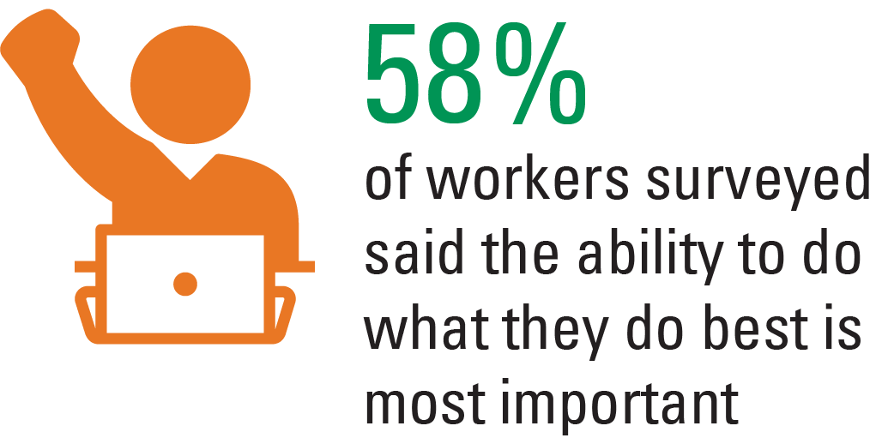
Source: The Top 6 Things Employees Want in Their Next Job, Gallup, 2/21/22
Notes:
Gallup recently asked 13,085 U.S. employees what was most important to them when deciding whether to accept a new job offered by a new employer.
A significant increase in income or benefits (64% said "very important")
Greater work-life balance and better personal wellbeing (61%)
The ability to do what they do best (58%)
When people have the opportunity to do work they’re naturally gifted at and trained to do, they enjoy their work, find it stimulating, and want to do more of it. Unsurprisingly, this item remains one of the most important for workers. Workers who aren't allowed to use their strengths very often seek jobs where they can; workers who do get to use their strengths seek out jobs where they get to use them even more.
Source: The Top 6 Things Employees Want in Their Next Job, Gallup, 2/21/22

Slide 14
Team Member Roles and Responsibilities (R&R)
Review R&R for each team member and determine whether any changes or adjustments are necessary
Does each team member understand how they’re accountable to their R&R?
Does each team member understand how they contribute to key team business goals?
Are R&R documented for each team member?
Is each person in their ideal role on the team?
Are they updated over time as team members have new personal and professional experiences?
Do they tap into the passions of each individual?
Notes:
That takes us to Roles and Responsibilities
Given the transitions you have been through and the work arrangements that have been in flux, I’m confident that roles have shifted over time
This is a good time to reassess each team member’s role. Is it written down and does the whole team know where to find the document? Are there metrics attached?
Begin the roles discussion with the team by asking each person to write down all the things they’re responsible for. I call it a 'total value inventory.’ Then ask each person to share their answers. It’s a great way to see gaps and overlaps in perceived roles and allows the team leader to assess what opportunities there may be for realignment.
If each team member understands how they contribute to the overall team goals and how their success is measured, it makes for a much more harmonious team foundation
One overlooked area in our industry, pertaining to roles and responsibilities, are team members’ life experiences and natural passions. We do a good job of aligning roles with professional designations, education, and past roles, but often we don’t consider their human experiences. Do team member roles tap into personal life experiences?
Let me give you an example. We’re so focused on our industry experience, education, credentials, past roles, etc. which are all crucial, but we can forget our people who have lots of different life experiences. For example, caring for aging parent or grandparent or public speaking and communication. Their role in your practice may have nothing to do with those things. Networking–are you tired of it? Could another member of your team take that over and feel energized and empowered? I believe we all have activities that fill our energy cup or drain it throughout the day. Are there small ways to align each person’s energy cup with one or two activates that add to it so they aren’t empty at the end of each day?
Roles should be a living, breathing document that will change over time. Consider assessing them at least semi-annually, if not quarterly, to ensure that they’re up to date, dynamic, and are accounting for the growth of the team members.

Slide 15
Proactive Services Delivered to Clients
Client Segmentation
Discuss any adjustments to service model as a team
Who will be responsible for implementing the changes?
Are there any clients who are no longer a ‘fit’?
Client Services
Are all team members using a central tracking system and entering notes consistently?
Is the proactive client service model documented?
How often does the team review?
Notes:
So much of the planning process centers around the client experience. I’m confident that is what you’ve worked tirelessly to execute on. Most teams tell me their processes don’t need much work.
Be careful of the phrase ‘Because we’ve always done it that way.’ That can immediately kill innovation. Be open to hearing team members’ ideas for change, enhancement, and innovation.
Also, be open to technology and tools that can help you deliver your client experience in a seamless way. Even if technology is not your passion, chances are that someone on the team would enjoy determining how tech tools could make your practice more efficient and effective.
Dig into the conversation around client segmentation. What clients should be moved up or down, as appropriate? What services are they receiving?
How often are you reviewing your service model? Are there tools and resources that the firm has that can be helpful as you innovate your processes? Does one person on the team ‘own’ the service model and propose proactive adjustments or enhancements over time?

Slide 16
Investment Implementation
Are all team members following the same process?
Is the process documented
Is regular communication regarding philosophy, ideas, and timing of changes delivered to all team members?
Does the team have a standardized investment review process that’s consistently used with clients?
Who drives the investment implementation and decisions for the team?
Is there additional investment training needed?
Notes:
The planning process is certainly not complete without an assessment of the investment implementation process. Is it formally documented? Does every member of the team know how to articulate it? Is there training needed for any individual or the entire team? Be open to discussing this with the entire team present. Most importantly, how are changes in direction, philosophy, asset allocation, etc. communicated across the team? It’s crucial that all team members are on the same page regarding implementation.

Slide 17
Business Growth Initiatives
Business Plan
Does every member have buy-in?
Is it clear who owns or leads each initiative?
Sourcing New Clients/New Assets
What is each team member’s commitment to growth?
How are practice growth metrics tracked?
Referrals
What is the team referral strategy?
Have you met clients’ adult children/grandchildren?
What do you know about your clients' parents?
Notes:
Having clarity on how each team member contributes to the busines growth is paramount. Discuss as a team, not only the metrics and goals, but who will be involved, what the expectation around prospecting for each team member looks like, and potentially expanding your multi-generational approach. Ask the team for ideas, be creative. I hear from teams every single day that their best ideas often don’t come from the most senior person on the team.
Think about the generations in your book. What do you know about your clients' parents? Their health, wealth? Do you know the next generation (or two) of your clients?

Slide 18
Case Study:
Setting Goals and Strategy
Notes:
Share case study

Slide 19
Principles
© 2022 by Hartford Funds. FOR FINANCIAL PROFESSIONAL/INSTITUTIONAL INVESTOR USE ONLY. NOT FOR USE WITH THE PUBLIC. This material is for informational (or educational) purposes only.
Notes:
Our last section is Principles

Slide 20
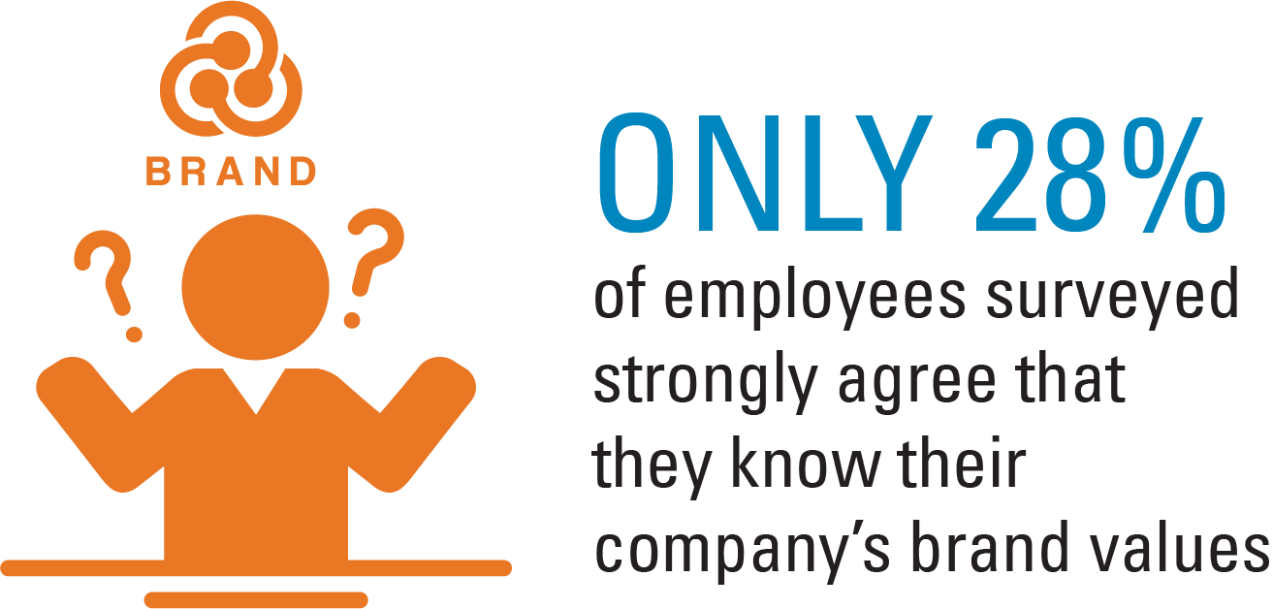
Source: Engaging Employees Starts with Remembering What Your Company Stands For, Harvard Business Review, 3/13/18
Notes:
One principle is what your practice is known for—your brand.
Team-member brand engagement is achieved when they’re aligned and involved with your brand. It requires you to have a clearly articulated brand identity and your leaders to cultivate a positive, multidimensional connection between team members and that brand identity. The goal is to make sure team members know what the brand stands for and are committed to reinforcing it with their actions.
Employee branding isn’t about selling anything or even telling employees what they should do. Rather, it’s about informing, inspiring, and involving employees so that they want to support and advance the brand.
Only when team members are engaged with the brand will they think and act in the specific ways that produce the specific results you’re seeking.

Slide 21
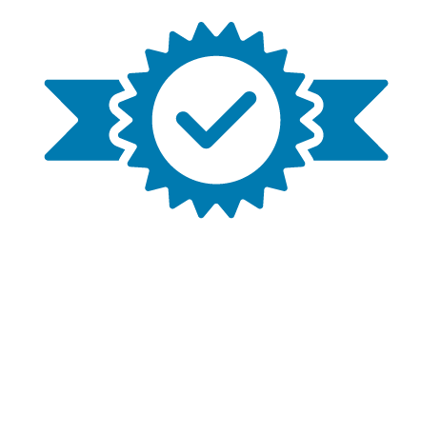
Marketing/Branding
Does your team focus on a specific niche? Has that focus been successful in growing the business?
Can each team member articulate the common team value proposition?
Does each team member use a consistent prospecting presentation when meeting with prospects?
Is there a consistent set of materials used when meeting with clients?
What marketing efforts is the team committed to in the upcoming year? Are they documented?
Notes:
You know your team and the work you’ve put into marketing and branding. Chances are, this has been a true focus and you feel very solidified. One question I often ask is this: If I were to sit down with each member of your team (individually) and say ‘tell me about your team’–would I hear a consistent story? Or if the team has 6 members, would I hear 6 different stories?
I have performed this exercise with countless teams, and it’s been very eye-opening. If each person is not articulating the same (or at least consistent) story, it’s very challenging to build a cohesive brand. Consider taking the time to assess your strategy, but also role-play and practice the articulation of it.

Slide 22
Succession and Business Transition
Is your current team comprised of individuals who are positioned to keep the business running into the future?
What could you do today to “future-proof” your practice?
What’s each person’s ideal retirement transition strategy (if applicable)?
What’s each team member’s ideal work schedule, e.g., hours worked per week; vacation schedule; remote work; snowbird schedule, etc.)?
Will it be necessary to expand your team? What’s the ideal new team member for your team?
Notes:
As you think of the future of your team, and the legacy you’ve built (or are building), what does the succession plan for your team look like?
Just like you encourage your clients to have an estate plan for your future, have you created the ‘estate plan’ for your practice? Have you engaged in open honest discussions with team members about the plan? Is it documented? If there’s not more than one financial professional today, what is the plan to integrate the next generation? (discuss questions)

Slide 23
Implementation and Accountability
What are key business metrics for this year?
Does each team member know how the metrics impact his/her professional development?
Are they documented in writing?
Has the team agreed on and written down the top 1-3 focus areas/initiatives for this year?
What will be the greatest impediment to successfully implementing these ideas?
Who holds the team accountable to goals?
Is there formal accountability feedback for team members?
Notes:
When thinking about setting business metrics and goals, think about attaching one or two team members’ names to each item. Remember the ‘we syndrome’ that we discussed earlier.
Accountability can be challenging because you like your team, and you respect them. In many ways, you’re like a family. You sit down together and create goals and have total buy-in. But are there times when goals aren’t met, or projects aren’t completed?
It could be because there’s not one person being held accountable for implementation. Think about how many times in a day you say the word ‘we.’ It’s usually out of respect for your team. But you cannot hold ‘we’ accountable.
‘We’ should have a client event
‘We’ should update our website
We, we, we…It’s a very collaborative and cohesive word but it doesn’t foster implementation of objectives. If I am being held accountable to revamp our marketing brochure and website, it doesn’t mean that I’m the one doing all the work. I’ll seek out advice, guidance, and help from the whole team, most likely.
Is the team truly focused on 1-3 clear goals for the upcoming year? These can be initiatives, projects, themes, overhauls, small adjustments, etc. Anything that’s meaningful to you. It’s imperative that everyone knows what these goals and how their contributions can help them happen.
Accountability is one of my favorite topics. I often ask teams who their accountability partner is. They always know. And then my next question is “Does that person know what role they’re playing for you?” I’ve found that often the engagement isn't formalized. I encourage you to reach out to whomever you consider to be an accountability partner and add clarity to your engagement, e.g., discuss mode, frequency of conversation, and what specifically they’re helping you accomplish. If you aren’t specific, it can be very challenging to measure success.

Slide 24
Case Study: Accountability

Slide 25
To Summarize
People
Reflect on last year’s successes
Process Documentation and accountability
Principles
One consistent value proposition
Notes:
To summarize (review three points)

Slide 26
“If you cannot see it, you cannot achieve it.”
Notes:
This is the time to set a team meeting and engage in the conversations. Don’t wait until a fresh month, quarter or year. Any time is the right time to reflect, communicate, and plan.
“If you cannot see it, you cannot achieve it”

Slide 27
Next Steps
Download our worksheet
Tailor the sample agenda
Put a team meeting date on the calendar.
Worksheet MAI367
Hartford Funds Distributors, LLC, Member FINRA.
REP_Redefine 2814120 0323
Notes:
Review next steps

