Slide 1


The Overprotective Brain
How to keep it from undermining your health, finances, and decision-making as you age
Notes:
Today we’re talking about something we all have—a built-in safety system in our brain. Everyone’s brain has this system, and honestly, it can get a little overzealous. You might be thinking: “Why are we talking about brains at an investment event?”
Most folks expect market trends and portfolio talk. Understanding those things can be helpful, but ultimately our audiences seem to be more concerned with how to live longer—and live better.
That’s why this topic fits right in. Our brains are wired to scan for threats, trying to keep us safe from anything that could go wrong. And as we get older, there’s plenty to guard against: market volatility, health changes, caregiving responsibilities, or the fear of outliving our savings.
That protective instinct is great—until it works overtime. Then it fuels worry and ramps up anxiety. Left unchecked, anxiety can drain your energy, strain relationships, and even mess with your health and finances. It clouds judgment, making it harder to think clearly and make smart decisions.
The good news? You can train your brain to chill out—and that’s what we’ll explore today. We’ve teamed up with Jennifer Shannon, a licensed therapist and author of Don’t Feed the Monkey Mind, to dig into why anxiety happens and share practical ways to break the cycle.
And before we get into those practical tools, let’s first look at why anxiety is so hard to get rid of in the first place. Jennifer highlights a key reason on the next slide.

Slide 2


Often, the very things we’ve been doing to try to control our anxiety are actually what maintains it.
Jennifer Shannon, LMFT
Cognitive Behavioral Therapist
Notes:
Meet Jennifer Shannon, licensed marriage and family therapist, who tells us that often the things people do to control anxiety are what keep it going strong. Wild, right?
Jennifer’s written great books like “Don’t Feed the Monkey Mind.” Today, we’re sharing why we can’t just “control” anxiety—and how trying to might actually fuel it.
Drawing from her own battles with anxiety and years of helping others, Jennifer’s got street-tested ways to help manage it—and we’ll share those strategies with you today. Now, let’s take a quick look at what’s ahead in our session.
The information provided in this presentation is for educational and informational purposes only. If you have questions or concerns about anxiety disorders or other aspects of this presentation, please consult a licensed mental health professional.

Slide 3

Agenda
What Is the Monkey Mind?
The Cost of Anxiety
Taming the Monkey
Notes:
Here are three areas we’ll consider [read slide]
Now, let’s discuss our first section: What is the monkey mind?

Slide 4

What Is the Monkey Mind?
Notes:
Let’s begin with our analysis in the first area…

Slide 5
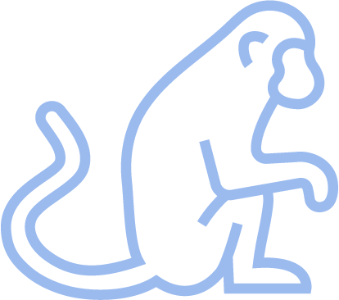
Origin | Ancient metaphor for a restless, distracted mind, like a monkey jumping from branch to branch
Modern use | Used in psychology and coaching approaches to describe a mind filled with mental chatter or racing thoughts
Understanding the "Monkey Mind" Concept
Notes:
We can all have a monkey mind at least on occasion! The term ‘monkey mind’ has been around for centuries. It originally comes from a Buddhist metaphor describing our restless, chattering thoughts—but today, it’s widely used in psychology and self-help to describe how our brains react to perceived threats. Think of it as an overeager safety guard, not a menace—it’s just doing its job a bit too well.

Slide 6
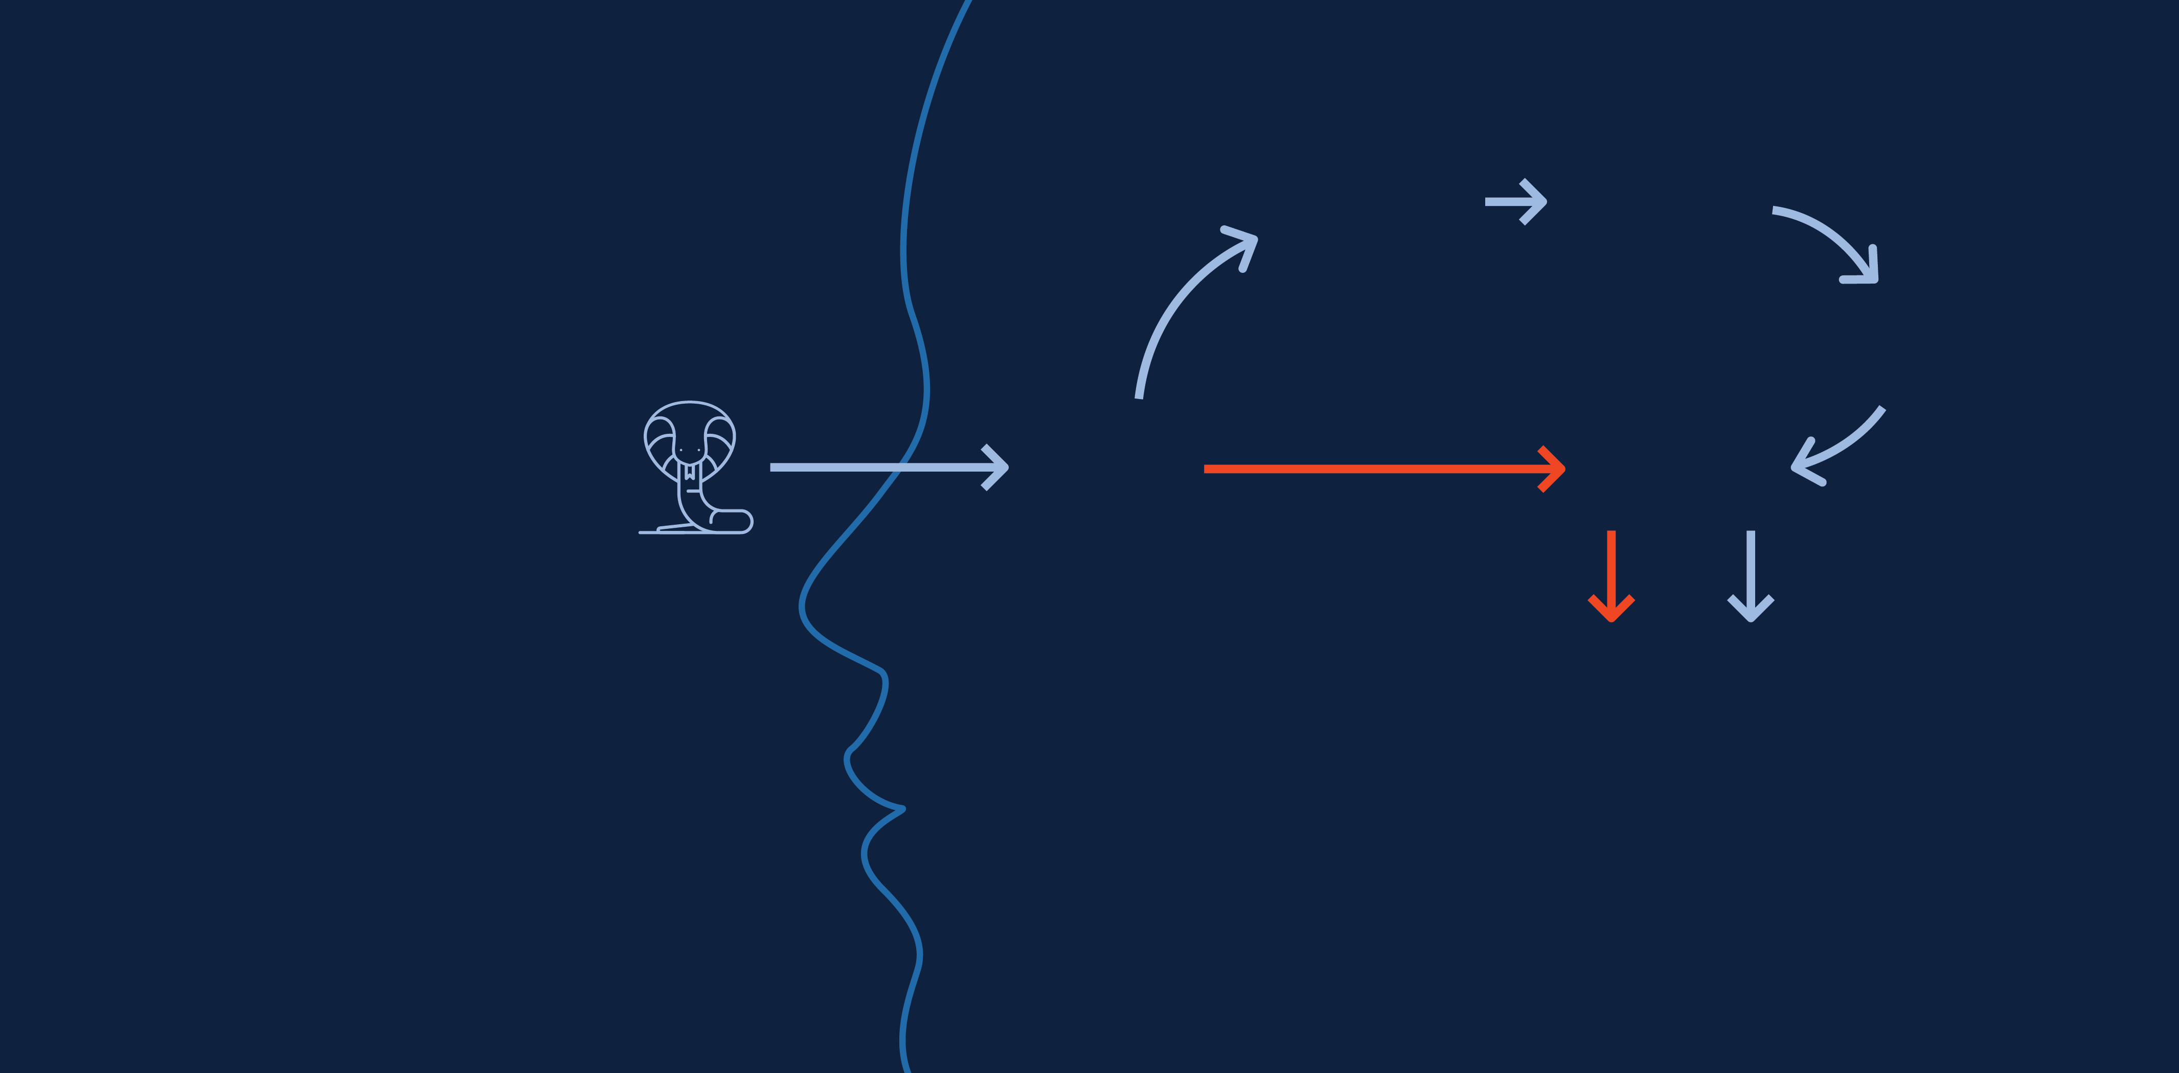
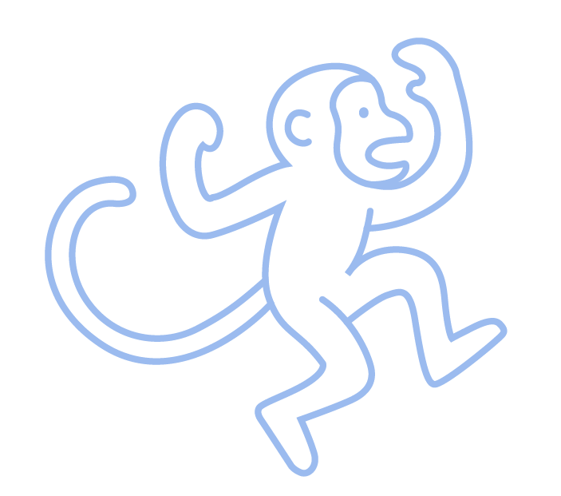

Sensory Cortex
Prefrontal Cortex
High Road
We’re All Susceptible to the Monkey Mindset
Hippocampus
Thalamus
(On)
Amygdala
Low Road
Fight/ Flight
Off
Hypothalamus
Source: MIT AgeLab
Notes:
To understand how the monkey mind operates, let’s explore this diagram. It shows the two pathways your brain uses to process threats—the fast “low road” and the slower, more rational “high road.”
Low Road (Fast but Basic): The thalamus quickly relays sensory information to the amygdala, which triggers an alarm—whether the threat is real or not. The hypothalamus then turns that alarm into physical stress—racing heart, sweating, and fight-or-flight mode. This path is automatic and reactive; there’s no time for fact‑checking, just instant fear.
High Road (Slow but Smart): This route takes a moment longer because the brain processes the sensory information more thoroughly, compares it with memories, and evaluates whether the threat is actually real. Because anxiety primes the low road, it often takes over. The amygdala fires before the prefrontal cortex has a chance to assess the situation and calm things down.
Imagine seeing a snake on a trail. Your monkey mind may keep you on edge during your next hike, scanning every stick, leaf, and shadow, convinced another snake is lurking. It might make you avoid certain parts of the trail or walk tensely, expecting trouble—or worse, stop hiking altogether. If the prefrontal cortex and hippocampus have their way, they’ll eventually step in to say, “Chill, it’s probably fine.”
[Detail on high road brain parts in diagram: Sensory cortex: Processes sensory information such as what you see, hear, smell, touch, and feel; Prefrontal cortex: Figures out what’s happening and meaning—it’s the CEO of your brain; Hippocampus: Remembers past experiences, especially stressful or threatening ones; Hypothalamus: Acts as the body’s stress switch—once the amygdala signals danger, it triggers the physical fight‑or‑flight response (heart rate, stress hormones, adrenaline).]
Now that we understand how it works, let’s dive into the two things it’s most scared of.

Slide 7
Purpose of the Monkey Mind— Protect Us From Primordial Threats
Death
Getting kicked out of the tribe
Notes:
The monkey mind’s whole gig is to protect us from two primordial threats—what Jennifer Shannon calls death and being kicked out of the tribe. “Primordial” just means stuff that’s been around since the beginning, baked into us. So, we instinctively dodge dangers like fire or cliffs—no one has to teach us that.
But it’s not just about physical survival—it’s social, too. Back in the day, our ancestors needed the tribe to survive, so the monkey mind got wired to obsess over social cues. It still does that today, noticing an awkward vibe when a friend seems distant or you feel out of place at a party. It’s just trying to nudge us back into the group’s good graces.
The monkey mind keeping us safe from death and rejection sounds pretty great—and in some ways, it is! But it’s not perfect, and it often makes two mistakes that can ramp up anxiety in our lives today. Let’s check those out.

Slide 8
Two Simple Mistakes of the Monkey Mind
It overestimates threats
It underestimates our ability to cope
Notes:
The monkey mind’s awesome at spotting obvious dangers—like rattlesnakes or bears—sounding the alarm to keep us safe. But today’s situations are way less clear, and that’s where it trips up with two big mistakes: it overestimates threats and underestimates our ability to deal.
Take a community lunch where a friend’s tone seems off. The monkey mind jumps in: “They’re mad at me, I don’t fit in, I’ll be ditched.” It doesn’t do odds—it just guesses, always playing it safe and blowing stuff up, which spirals fast: “I’ve upset them, they’ll reject me, I’ll lose everyone, I’ll be alone forever.” I know that sounds extreme, but that’s the monkey mind overestimating threats to keep us safe—it’s tapping into the old fear of being kicked out of the tribe.
Or take a work slip-up. The monkey mind frets: “I’m done, I’ll get fired.” That spirals too: “I’ll have no money, I’ll starve, I’ll die.” Again, it sounds extreme, but that’s the overestimation at play, tied to the fear of death. Plus, it underestimates our ability to deal, making us feel helpless when we’re actually way more capable.
The monkey mind often sees threats in three key areas. Let’s check those out next.

Slide 9

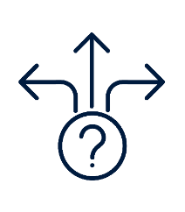


Intolerance of Uncertainty
I must be 100% certain
Perfectionism
I must not make mistakes
How the Monkey Views the World (The Monkey Mindset)
Over-responsibility
I’m responsible for everyone’s happiness and safety
Notes:
We all, from time to time, get caught up in ways of thinking that spark anxiety. These are three assumptions that can sneak into anyone’s mind. Drawing from Jennifer Shannon’s work, we’ll call them the monkey mindset because they reflect those primal instincts that don’t always lead us where we want to go.
Intolerance of uncertainty: I must be 100% certain.
Perfectionism: I must not make mistakes.
Over-responsibility: I am responsible for everyone’s happiness and safety.
These thoughts can tug at any of us, often holding us back from the life we truly want. Over the next few slides, we’ll explore each one in more detail to see how they show up and what we can do about them.

Slide 10
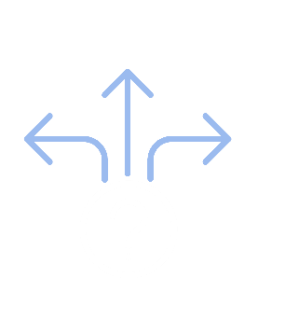
Intolerance of Uncertainty I must be 100% certain
Worrying about finances, health, family
I check my portfolio constantly
I imagine worst-case scenarios
Unless I hear from loved ones, I’m worried sick
Difficulty making decisions
Paralysis by analysis
I lean heavily on other people’s input
I put off making decisions
Getting upset when things don’t go as planned
I over-plan
I attempt to control situations
Forgetting something would be terrible
Notes:
The first part of the monkey mindset is intolerance of uncertainty—it’s like, “I have to be 100% sure!” Will I get sick? Will the market crash? Are my loved ones okay?
We crave certainty in these situations. But when certainty isn’t possible, we might begin to worry. That’s our monkey mind starting to chatter.
It thinks: “If you don’t know, you’re in danger!” It can push us to think we can only chill when everything’s predictable. So, we overthink every decision, assuming we’ll always pick right if we’re careful enough. Anything new? It’s risky until proven safe. We brace for the worst, like it’s coming any second.
But here’s the deal: life’s full of unknowns. Chasing certainty all the time can make us restless, on edge, or overwhelmed—that’s anxiety creeping in. To make matters worse, we tend to underestimate our ability to cope with those unknowns.
Instead of living and enjoying life, we may miss out on the good stuff because we’re too busy worrying.
[Read a few categories and bullets.]
You might be thinking some of these don’t sound so bad—like seeking advice from others. And that’s true, they’re not. But when it gets extreme, like, “I can’t decide until I’ve asked literally everyone for advice,” that’s when anxiety might be kicking in.
[Share a quick story—like how you were anxious about past market drops]
Do any of these ring true for you—or for friends or family who struggle with uncertainty?
[Pause for responses. If no one answers, you can say: Here are a few examples of things aging adults often worry about:
Whether their aging parents should stop driving. If they’ll need long-term care and how much it might cost. Whether the market will crash right after they retire. If they’ll outlive their savings. Whether adult children will need financial help—and how often.]
Next, let’s talk about the second assumption: “I must not make mistakes.”

Slide 11

Perfectionism I must not make mistakes
Worrying about what others think about you
I avoid meeting new people, joining groups
I assume others’ thoughts (e.g., ‘They think I’m a failure’)
I think too much about what I'm going to say
Procrastination
I over-research before deciding
I delay tasks due to fear of imperfection
I make excuses to avoid starting tasks
Overworking and stress
I can't relax because I feel there's always more to do
I sacrifice my personal life for work
I set excessively high standards for myself
Notes:
Lots of us pride ourselves on high standards—we aim big and want the best. That’s what people often call perfectionism. But the monkey mind cranks it up a notch. It’s like, “You can’t mess up—ever!” Anything less than perfect feels like a total fail. Its motto? “Don’t mess this up!” You only feel okay when everything goes perfectly—every task, every conversation.
It often hits when you feel your spot in the group is at risk. Worried about family, friends, or bosses judging you? The monkey mind freaks out, thinking a mistake could get you kicked out of the tribe—less respect, fewer allies, maybe even rejection. That pressure makes us tense, stuck, or anxious.
The slide lists ways this shows up, like avoiding risks or over-checking work. Sound familiar?
[Share a quick story—like when you panicked about nailing a presentation, or Age Lab Jennifer’s client Eric, who skipped his company’s holiday party because he was terrified of saying something dumb, even as a founder.]
[Optional group exercise: Do you ever catch yourself, or people you know, doing any of these? Talk to the people at your table about your experiences with any of these bullets.]
[Some common things aging adults often worry about when perfectionism kicks in: Can’t decide which investments to go with; skipping a fitness class, lesson, or game night because they might make mistakes or look inexperienced; procrastinating Social Security filing decisions.]
There’s a quiz in the workbook to see how much this affects you. Next, let’s dive into over-responsibility.

Slide 12

Over-Responsibility I’m responsible for everyone’s happiness and safety
Chronic worry about people you care about
I try to manage what others do because I worry about them
I give unsolicited advice
I step in or check repeatedly—even when it may not be needed
Ignoring Your Needs
I have difficulty saying no to others
I take on more than my fair share of work
My happiness relies on others’ happiness
Guilt
I should be able to keep bad things from happening
I can’t be happy if my loved ones aren’t
I blame myself when others get upset
Notes:
Being called responsible is a great compliment. At home, it means supporting loved ones emotionally and financially, building strong families. At work, it’s about stepping up, taking on extra tasks, or pitching in beyond what’s expected, which can lead to growth and recognition.
But it’s possible to take responsibility too far.
The monkey mind’s over-responsibility mindset convinces us we need to do more than our fair share to keep family and friends safe. It’s what drives people to always say yes—to be the one who stays late, sets things up early, or volunteers when no one else does. At family gatherings, it’s the host fretting over everyone’s happiness.
This mindset often stems from a fear of letting others down. We might focus on pleasing bosses, coworkers, friends, relatives, or even strangers, sometimes at the expense of our own needs. For example, consider Samantha, a client of Jennifer Shannon’s. Her son struggled with alcohol addiction, and for years, she drained her savings and neglected her health to “save” him—paying his rent, pushing him into rehab. She felt she had no choice, thinking, “As long as my son’s in pain, I have to fix it,” or “If something bad happens to him, it’s my fault.”
The biggest burden comes when we feel responsible for others’ well-being and safety. We’re taught to care and help out, but this mindset can make us believe it’s our duty to fix someone’s poor choices or ease their pain before we can feel okay ourselves. That pressure can leave us drained, guilty, or anxious, as we try to control things beyond our reach.
The slide shows behaviors like always saying yes or feeling guilty for setting boundaries. Do any of these ring true for you or people you know?
[Presenter—Share a personal story about a time you, or someone you know, felt anxious about taking on too much responsibility for others. Other “over-responsibility” related topics for aging adults: Covering adult children’s bills, feeling obligated to babysit grandkids, Daily check‑ins with aging parents, Hosting and funding every holiday or gathering.]
These three assumptions—certainty, perfection, and over-responsibility—often drive people to adopt habits that feel protective. We call them safety strategies. They’re the things people do to avoid anxiety—like over-researching, delaying decisions, or taking on too much for others. The problem? Instead of fixing anxiety, these strategies feed it. Next, we’ll look at what those safety strategies are and why they keep the anxiety cycle going.

Slide 13
Avoiding speaking up in meetings
Trying to solve other people’s problems for them
Review the past, looking for mistakes
Avoiding traveling, airplanes, trains
Always staying busy at home or at work
Safety Strategies Feed the Monkey
Things we do to keep the thing we’re worried about from happening
Avoiding saying “no”
Seeking excessive information (on the internet, from doctors)
Procrastinating
Prioritizing others’ needs over your own
Redoing things to make sure you have them right
Thinking too much about what you are going to say
Avoiding making decisions on your own
Notes:
All those things we talked about on the last few slides, like [read a few from the slide], Jennifer Shannon calls safety strategies.
They’re automatic behaviors we use to dodge anxiety from intolerance of uncertainty, perfectionism, or over-responsibility. These reflexive actions—like a monkey mind reacting to its own alarm—aim to avoid discomfort and “eliminate risk.” They bring brief relief, but it doesn’t last.
Every time we rely on a safety strategy, we give the monkey exactly what it wants—short‑term relief and a sense of safety. Jennifer Shannon calls this “feeding the monkey.”
The problem? These habits don’t fix anxiety—they fuel it. They’re so ingrained in daily life that they’re hard to spot, but they hold you back.
For example, obsessively checking your portfolio might feel safe but derail long-term financial goals. Skipping a party might seem easier but cost you connections.
Next, we’ll explore the anxiety cycle and how safety strategies keep it going.

Slide 14
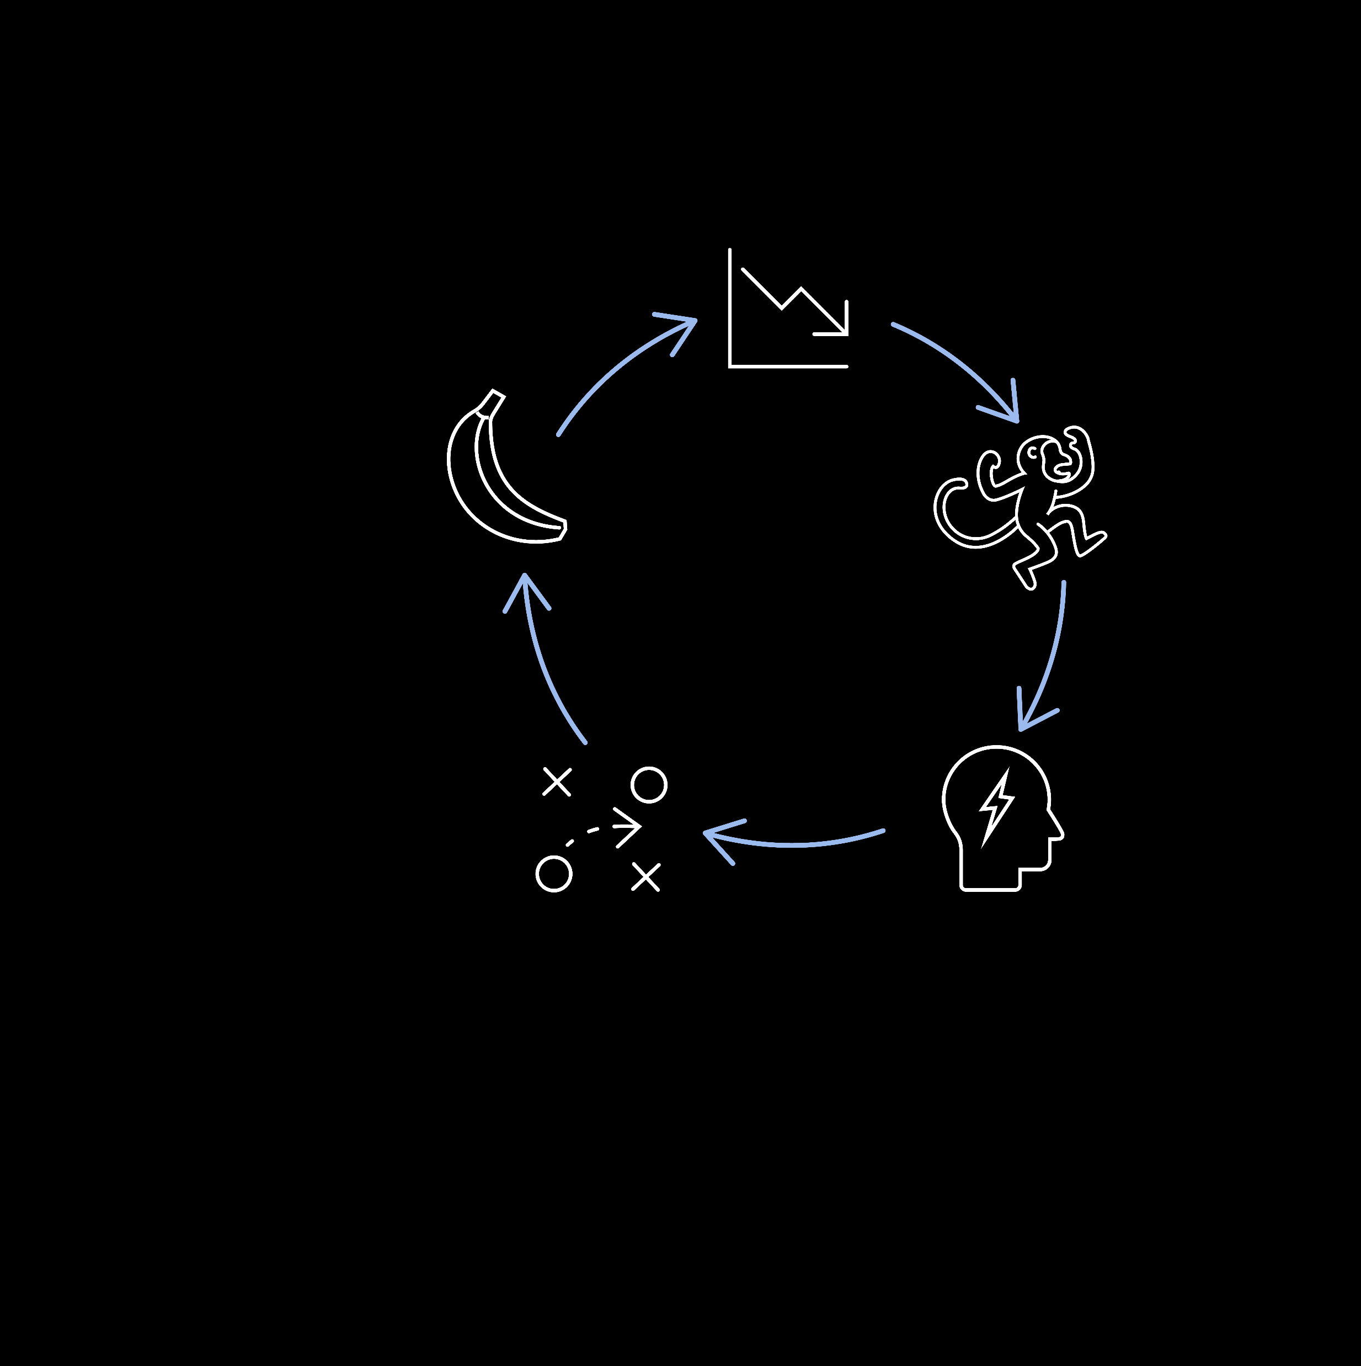
Stimulus:
A big market drop
Monkey Mind:
The market is tanking
I could lose it all
I won't be able to retire
Do something!
The Anxiety
Cycle—
Volatile Market
Confirmation: Good move!
Anxiety: Stress chemicals can hijack rational thinking
Safety Strategy:
Change portfolio
Notes:
Let’s explore the anxiety cycle—a trap that keeps people stuck in worry and avoidance.
Let’s imagine a day—or several days—when the stock market plummets. The monkey starts screaming: “The market is tanking! Do something!”
Anxiety kicks in, driven by the Monkey’s chatter. And once your fight-­or-­flight reflex is activated, the chemicals, hormones, and emotions at work in your body hijack the rest of your brain.
So, we reach for a safety strategy—maybe we shift our portfolio into safer investments. That action brings short-term relief.
And the monkey relaxes, thinking, “Good move—you could’ve lost everything.” That’s the monkey confirming that the safety strategy was a good move, reinforcing the cycle and making it more likely to repeat that decision next time.
But here’s the problem: Does changing the portfolio make someone feel better in the moment?
Absolutely.
Could it hurt their chances of reaching long-term goals? Probably.
That’s the cost of reinforcing the cycle—short-term gain, long-term pain.
Next, we’ll look at another anxiety loop—how perfectionism can mess with your social life by making you worry about what others think.

Slide 15
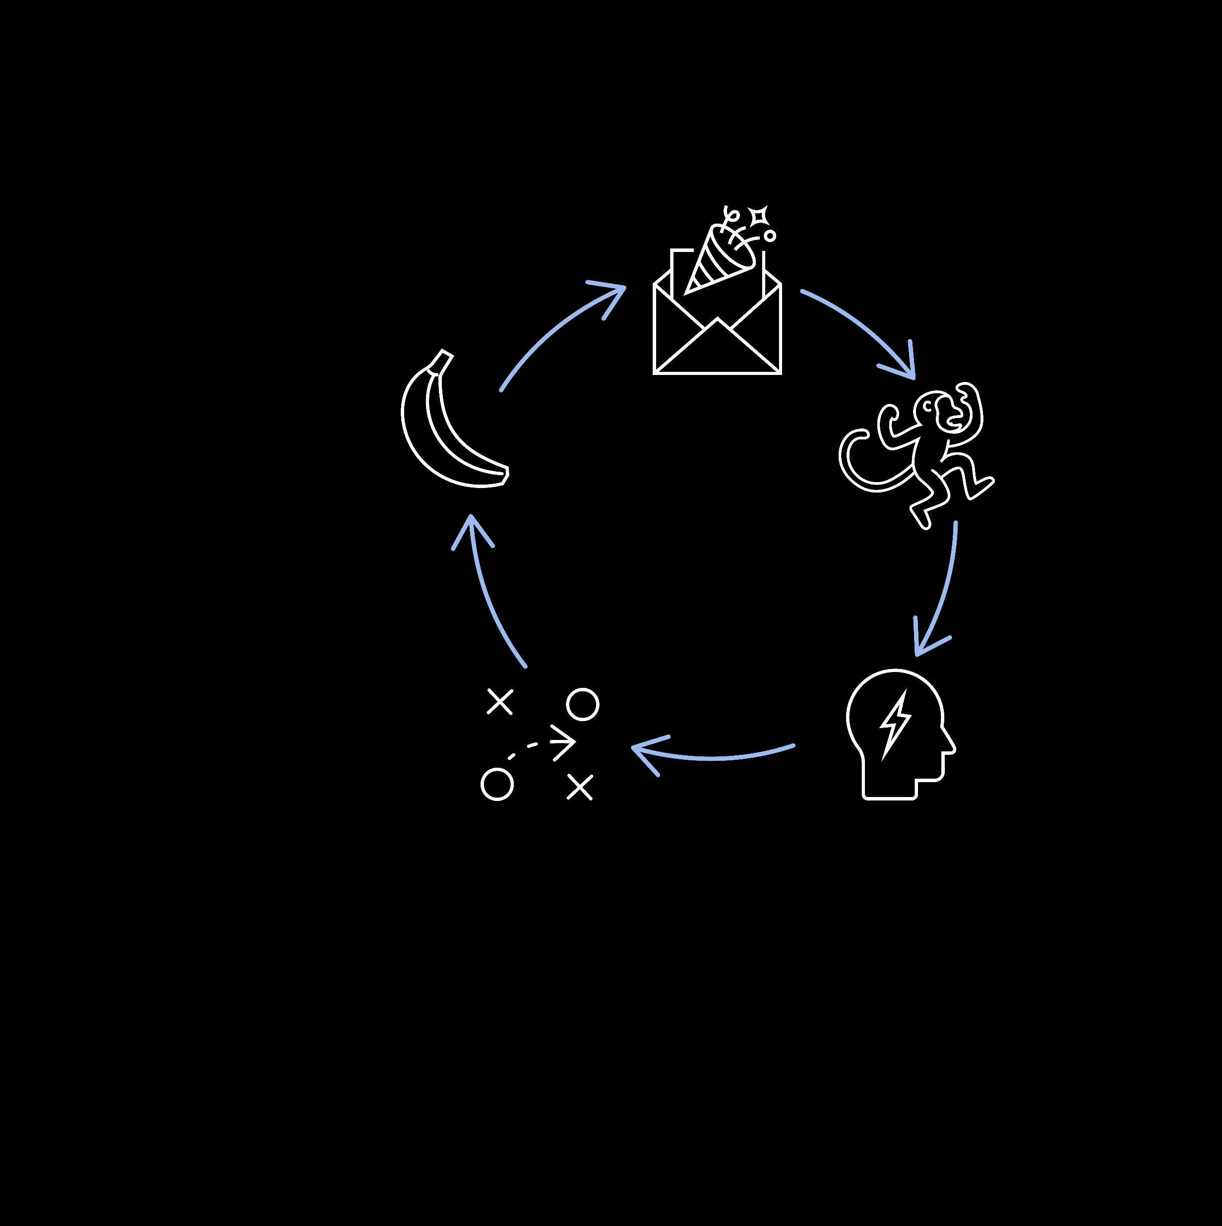
Stimulus:
A party invitation
Confirmation: Good move!
Monkey Mind:
I won’t fit in
I’ll say something stupid
I’ll make a fool of myself
The Anxiety Cycle—
Social Gathering
Anxiety: Stress chemicals can hijack rational thinking
Safety Strategy:
Stay home
Notes:
Here’s another example of how the anxiety cycle shows up.
Imagine someone invited to a social gathering to see how this cycle unfolds.
Anxiety kicks in when the monkey mind detects the risks of the party invite.
It’s not mild worry; the monkey sees a full-blown disaster ahead. The chatter erupts: “You won’t fit in! Do something!” Anxiety spikes hard when they think: “I’ll say something stupid and they’ll think I’m an idiot.”
So the safety strategy swoops in: “Better not go—stay safe.”
The monkey, just trying to do its job, confirms: “Good call—you would’ve made a fool of yourself.”
That avoidance tells the monkey its outsized fears were right—locking the cycle tight.
Next invite?
Same frantic loop.
This cycle can rob us of big joys—like fun nights and deep connections, the stuff that keeps us thriving as we age.
Next, we’ll look at the real costs of anxiety and why breaking this cycle matters.

Slide 16

The Cost of Anxiety
Notes:
In this section, we’ll uncover the true costs of anxiety. We just explained how the monkey wants to be fed and how it feels better. The problem is, feeding the monkey may not be the best thing for you.

Slide 17
Stimulus:
Big Drop in the Market
Monkey Mind:
The market is tanking
I could lose it all
I won't be able to retire
Do something!
The Anxiety Cycle—
Volatile Market
Confirmation: “Good Move”
Anxiety: Stress chemicals can hijack rational thinking
Safety Strategy:
Change portfolio
Notes:
Remember this slide? I’m bringing it back because we’re about to show what this cycle can cost people in dollars and cents. Just a quick recap: when markets swing, the anxiety cycle kicks in fast. The monkey mind screams, “Do something!”
Some people may reach for a safety strategy—like shifting to safer investments. It feels smart in the moment, but it reinforces the cycle and can lead to worse outcomes over time.
Now, let’s look at real-world data that reveals what people actually do when volatility spikes—and how those reactions can impact long-term results.

Slide 18
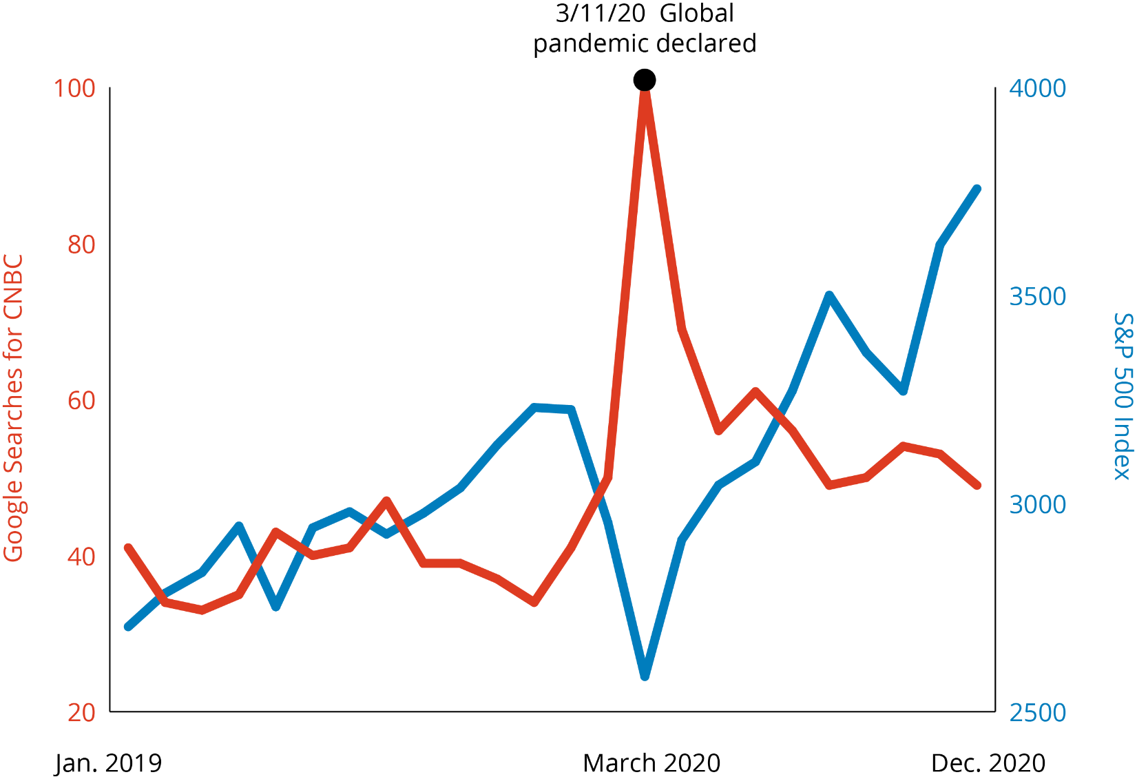
The Monkey Mind Seeks Negative Information
Google searches for CNBC¹
S&P 500 Index²
Google Searches for CNBC vs. S&P 500 Index
PAST PERFORMANCE DOES NOT GUARANTEE FUTURE RESULTS.
The S&P 500 Index is a market capitalization-weighted price index composed of 500 widely held common stocks. For Illustrative purposes only. Indices are unmanaged and not available for direct investment.
Google Trends Methodology: Google Trends enables you to compare the world’s interest in various internet topics; it shows how frequently topics have been searched on Google over time. The numbers on the graph reflect how many searches have been done for a particular term, relative to the total number of searches done on Google over time. They don’t represent absolute search volume numbers, because the data is normalized and presented on a scale from 0-100. Each point on the graph is divided by the highest point, or 100. A rising line for a search term indicates a growth in the term’s popularity.
¹Data Source: Google Trends, 12/23 ²Data Source: Factset, 12/23
Notes:
This chart shows two things side by side: the sharp market drop in early March 2020 and Google searches for CNBC. See that spike in searches? That’s the monkey mind in action. Right as the World Health Organization declared COVID-19 a global pandemic, the monkey went on high alert—sounding alarms, scanning for danger, and devouring negative news in a frantic search for safety.
Investors searched CNBC for answers, driven by one goal—safety. Then—bam—on March 16, the S&P 500 dropped 12%, and the Dow fell 2,997 points in a single day.* The monkey screamed, “Do something! Stop losing money!” Playing it safe by moving to safer investments felt smart—but ended up costing some investors.
And even though the S&P 500 had dropped about 34% by late March 2020, it finished the year up more than 16%—a reminder that the market can recover far faster than our monkey mind expects.**
Next, we’ll see how moves to safer investments can affect returns.
*Largest one-day point losses of the Dow Jones Industrial Average (DJI) from 1897 to June 2023, Statista, 1/3/24
**Google Finance, 2026

Slide 19
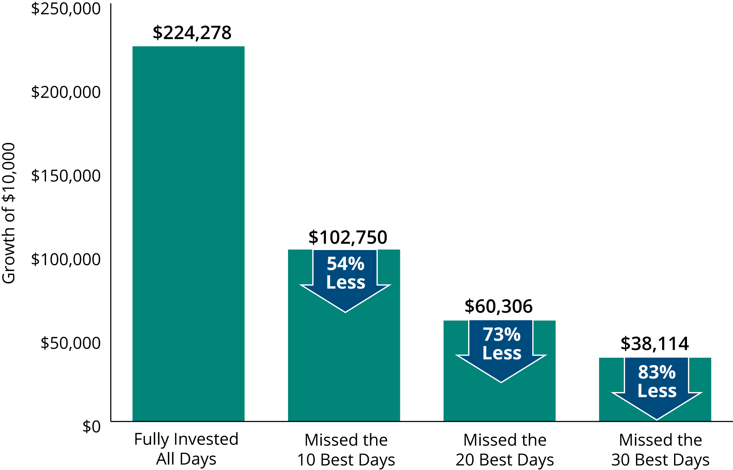
Missing the Market’s Best Days Has Been Costly
S&P 500 Index Average Annual Total Returns: 1995–2024
Financial Cost
Past performance does not guarantee future results. For illustrative purposes only. Data Sources: Ned Davis Research, Morningstar, and Hartford Funds, 1/25.
For illustrative purposes only. Data sources: Ned Davis Research, Morningstar, and Hartford Funds, 1/25.
Notes:
Alright, let’s keep rolling from where we left off.
Picture this: the market’s tanking, and the monkey says, “Play it safe!” So you decide to take drastic action to make your portfolio safer. Feels like you’ve outsmarted the chaos, right? But here’s the catch—the monkey’s short-term strategy can backfire.
This graph shows the S&P 500 average annual total returns from 1995 to 2024. The first bar? Someone who invested $10,000 and stayed fully invested for the entire 30‑year period—they ended up with about $224,000. Now look at the next bar—miss just the 10 best days and returns drop to $102,750. That’s a 54% loss.
It gets worse. Miss the 20 best days, and you’re down to $60,306—a 73% drop. Miss 30 days? $38,114—an 83% loss. The crazy part? We’re talking about less than a month over 30 years. Those few days matter a ton.
As we can see, feeding the monkey’s fear can lead to a massive financial cost. Next, we’ll see how the monkey’s push for safety can also take a toll on health.

Slide 20

Stimulus:
Invited to a party
Confirmation: “Good Move”
Monkey Mind:
I won’t fit in
I’ll say something stupid
I’ll make a fool of myself
The Anxiety Cycle—
Social Gathering
Anxiety: Stress chemicals can hijack rational thinking
Safety Strategy:
I’ll stay home
Notes:
Remember that party example? Skipping it felt safe—it fed the monkey. But that choice came with a cost.

Slide 21
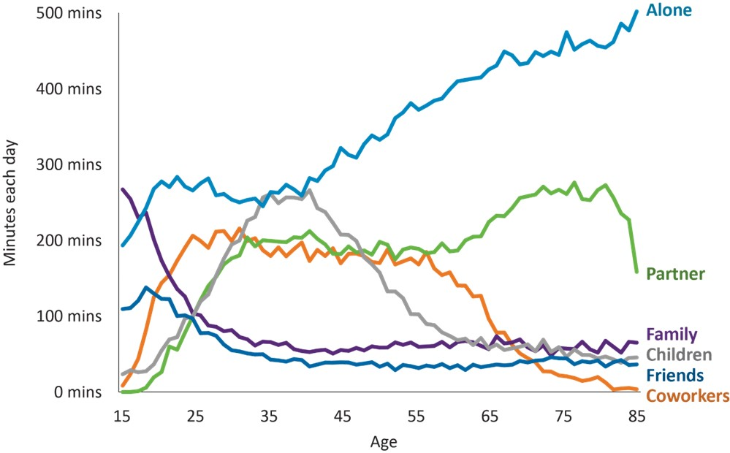
Who Americans Spend Their Time With by Age
Social Cost
Source: Visualized: Who Americans Spend Their Time With, Visual Capitalist, 10/28/22. Most recent data available.
Notes:
Check out this graph—it shows who Americans spend time with as they age: partners, family, friends, coworkers, or alone. Notice the trend? As we get older, time with others shrinks, and time alone grows.
But here’s the kicker: this chart doesn’t account for anxiety. When the monkey mind pushes people to decline social invites—like in that party example—they can end up spending even more time alone than this graph suggests.
That extra isolation can take a serious toll on health and happiness. Next, we’ll see just how dangerous loneliness can be.

Slide 22


Between
20% and 25%
of older adults 50+, aren’t in regular contact with other people
Loneliness
is as lethal as smoking 15 cigarettes per day
⁸ Loneliness Is as Lethal As Smoking 15 Cigarettes Per Day. Here's What You Can Do About It, Inc. 8/18/18.
Source: An Age-Old Fear Grows More Common: ‘I’m Going To Die Alone’ KFF Health News, 10/16/25
Notes:
Nearly one in four adults over 50 aren’t in regular contact with anyone. Think about that—millions of people spending most days completely alone. About one in four older adults living at home are socially isolated. And that matters—greater isolation raises risks of disability, dementia, and even mortality. Researchers have found loneliness is as lethal as smoking 15 cigarettes a day.
Here’s the twist: this isn’t just about aging—it’s about anxiety. When the monkey mind exaggerates social fears and pushes people to avoid social gatherings, it can accelerate this isolation. The monkey thinks it’s keeping them safe from judgment or rejection—but that “safety” can quietly harm health and longevity.
Next, we’ll look at another cost of feeding the monkey: how choosing safety over personal values can shrink life’s possibilities.

Slide 23



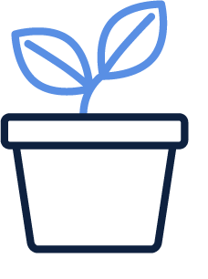

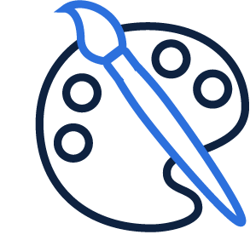
Personal Cost
Which Will We Choose?
Adventure
Courage
Growth
Vs.
Safety
Social connection
Creativity
Fun
Notes:
Listening to the monkey’s chatter can also cost us personally. The monkey always votes for safety. It pushes people to avoid risks—like judgment or failure—nudging them toward perfection or people-pleasing. If we let fear lead, we might choose safety over values that matter most—like connection, growth, or creativity.
Think of when we were kids, drawing or singing freely—until criticism stung. That sting taught the monkey to play it safe: “Don’t mess up, just blend in.” So we stop taking chances, telling ourselves, “I can’t afford to fail.” But that’s not living—it’s surviving.
This slide shows the choice: safety or values. The monkey will always push for zero risk, but values like fun, adventure, and courage make life feel full. Noticing when we choose safety over values is key—because those values often matter far more than avoiding discomfort.
Next, we’ll look at practical ways to tame the monkey—and tools we can use when anxiety flares up.

Slide 24

Taming the Monkey
Notes:
Here’s our last section, “Taming the Monkey Mind.”

Slide 25

Expansive Strategies
Notes:
The first step in taming the monkey mind is learning about expansion strategies—a concept developed by Jennifer Shannon. Imagine a flat world where sailors stuck close to shore, afraid of falling off some mythical edge. That’s the monkey mind at work—clinging to safety because the unknown feels dangerous. Captains hugged the coast to reach distant lands, and every safe return cemented that caution.
Anxiety can keep us “near shore,” making our world small. Expansion strategies break that cycle, opening new possibilities. They don’t wipe out anxiety—they help us challenge the monkey’s chatter and move forward even when anxiety flares.
Next, let’s see how expansive strategies are the opposite of monkey mind strategies.

Slide 26
Monkey Mindsets |  | Expansive Mindsets
I must be certain |  | I am willing to be uncertain
I must be perfect |  | I can make mistakes
I’m responsible for everyone and everything |  | I’m primarily responsible for myself
Replace Monkey Mindsets With Expansive Mindsets
Notes:
When we think about expansive mindsets, I’m reminded of a conversation I had with my friend Kevin Elko, a cognitive psychologist. Kevin once said, “I’m a cognitive psychologist—do you know what that means? It means I specialize in one phrase: ‘I say to myself.’” That stuck with me. Because if we can change the stories we tell ourselves—the things we repeat in our own heads—imagine what could happen.
What if we could flip monkey mindsets into expansive mindsets? Anxiety thrives on monkey mindsets—like “I must be certain,” “I must be perfect,” or “I’m responsible for everything.” These beliefs can keep us stuck in worry and fear. Jennifer Shannon suggests an effective way to manage anxiety is to change the story we tell themselves. Instead, say: “I’m okay with uncertainty,” “I can make mistakes,” and “I’m primarily responsible for myself.”
It’s not easy. We might feel good about this shift when we’re thinking about trying it, but when life gets tough, those old mindsets creep back. That’s because we’ve spent years reinforcing them. A new mindset won’t stick without new experiences to back it up. It’s like training for a marathon—you can dream about it, but you won’t believe you can do it until you start running.
So how do we make expansive mindsets stick? Stop feeding the monkey! Every time we use a safety strategy, we confirm the monkey’s fear was right—making it louder next time. Swapping safety strategies for expansive ones breaks that cycle and creates new experiences. At first, this might make us more anxious—and that’s okay. Feeling anxious means we’re on the right track. We’re telling the monkey, “I can handle this without being perfect.” Over time, that weakens the fear instead of reinforcing it.
Next, let’s look at how to put expansive mindsets into action.

Slide 27

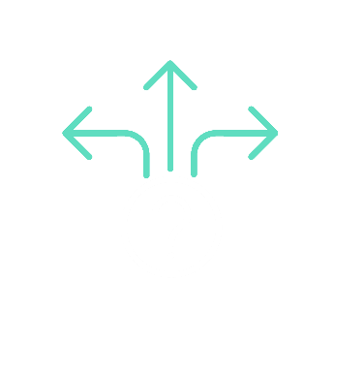
Situation: Jim experiences market volatility
Monkey Mindset: “I might lose it all!” | Safety Strategy: Checks his portfolio multiple times a day
Expansive Mindset: “My portfolio is designed to weather volatility.” | Expansive Strategy: Checks his accounts just once a week
Expansion Strategy Table:
Intolerance of Uncertainty
Notes:
Expansion tables are effective because they help us spot the monkey mind in action—and choose a response that calms it instead of feeding it.
Let’s walk through an example.
Situation: Jim experiences market volatility. He’s retired and keeps a close eye on his investments.
Monkey Mindset: When the market drops, his monkey mind kicks in: “I might lose it all!” That fear drives his next move. Jim’s anxiety is driven by intolerance of uncertainty—one of the three monkey mindsets we discussed earlier. His brain believes that if he’s not 100% sure his money is safe, he’s in danger.
Safety Strategy: He checks his portfolio multiple times a day. It feels rational, but it reinforces the monkey’s fear—making it louder next time.
Expansive Mindset: “My portfolio is designed to weather volatility.” This mindset takes a different view, reminding Jim that his plan was built for ups and downs.
Expansive Strategy: And finally, the expansive strategy box: Jim tries checking his accounts just once a week instead of multiple times a day. It’s a small step, but a powerful one.
At first, it feels uncomfortable. That’s normal. That discomfort is a sign he’s doing something new—something that challenges the monkey’s grip. And with practice, his brain learns: “I can handle this. I don’t need constant certainty to feel secure.”
That’s how Jim begins taming the monkey mind—not by eliminating anxiety, but by proving he can act on his values even when the monkey is loud. And that’s where real confidence begins.
Next, we’ll look at an expansion strategy table that tackles a different mindset—perfectionism.

Slide 28


Situation: Linda is invited to a neighborhood gathering
Monkey Mindset: I’ll probably say something dumb and make a fool of myself | Safety Strategy: Better stay home
Expansive Mindset: I don’t need to be perfect—just present | Expansive Strategy: Say yes to the invite. Start a conversation by asking someone a simple question—like “Where are you from?”
Expansion Strategy Table:
Perfectionism
Notes:
This is an expansion table focused on perfectionism—a monkey mindset that often drives anxiety. Let’s walk through how this plays out and how we can flip it into an expansive approach.
Situation: Linda is invited to a neighborhood gathering—a casual event with friendly faces.
Monkey Mindset: Instead of feeling excited, she’s flooded with dread. Her mind races: “What if I say something dumb? What if I freeze up? What if they think I’m awkward or boring?” The monkey mind is convinced that any slip‑up will lead to judgment or rejection. That pressure turns a simple invite into a high‑stakes test.
Safety Strategy: She declines the invite, saying she’s too busy. It feels safer to stay home than risk embarrassment. But this avoidance reinforces the monkey’s fear—teaching her brain that social situations are dangerous.
Expansive Mindset: “I don’t need to be perfect—just present.” This mindset is the sort of opposite of the monkey mindset. It’s not about impressing—it’s about connecting.
Expansive Strategy: And finally, the expansive strategy box: Linda says yes to the invite. Notice how this is opposite of the safety strategy. She doesn’t rehearse every word—she simply starts a conversation by asking someone a question, like “Where are you from?” It’s a small step, but a powerful one.
At first, it feels uncomfortable. That’s normal. That discomfort is a sign she’s doing something new—something that challenges the monkey’s grip. And with practice, her brain learns: “I can handle this. I don’t need to be flawless to belong.”
That’s how Linda begins taming the monkey mind—not by eliminating anxiety, but by choosing values like connection and authenticity over fear. And that’s where real confidence begins.
Next, we’ll look at an expansion strategy table that tackles a different mindset—over-responsibility.

Slide 29

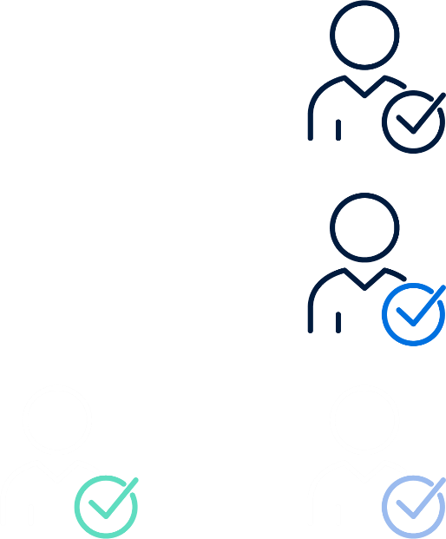
Situation: Denise keeps helping her adult kids with money—even though it’s starting to stretch her finances
Expansion Strategy Table:
Over- Responsibility
Monkey Mindset: If I don’t help them out, they won’t make it | Safety Strategy: I help with rent, debts, and bail them out whenever they’re short
Expansive Mindset: They may be more capable than I realize | Expansive Strategy: Set clear boundaries and offer guidance instead of money
Notes:
Let’s look at how over-responsibility can show up in family finances.
Situation: Denise keeps helping her adult kids with money—even though it’s starting to stretch her finances.
Monkey Mindset: If I don’t help them out, they won’t make it. Her monkey mind tells her: “If I don’t buy this for them, they can’t work, they won’t be able to keep a job, then they won’t be able to feed the kids. I’ve got to give in.” That fear drives her next move.
Safety Strategy: She helps with rent, pays off debts, and bails them out whenever they’re short. It feels like the right thing to do, but these repeated bailouts don’t just drain her resources—they also reinforce the monkey’s fear that her kids can’t handle things on their own.
Expansive Mindset: “They may be more capable than I realize.” This mindset shifts the focus from control to trust, reminding Denise that her kids can learn and grow without constant rescue.
Expansive Strategy: And finally, the expansive strategy box: Denise sets clear boundaries and offers guidance instead of money. She’s still supportive—but she’s not solving every problem for them. Again, notice that this strategy is the opposite of the safety strategy.
At first, it feels uncomfortable. That’s normal. That discomfort is a sign she’s doing something new—something that challenges the monkey’s grip. And with practice, her brain learns: “I can handle this. I don’t need to fix everything to feel secure.”
That’s how Denise begins taming the monkey mind—not by eliminating anxiety, but by choosing values like trust and healthy boundaries over fear. And that’s where real confidence begins.
Next, we’ll move into an exercise where you’ll create your own expansion strategy table.

Slide 30
Situation:
Monkey Mindset: | Safety Strategy:
Expansive Mindset: | Expansive Strategy:
Expansion Strategy Table Exercise
Notes:
We can use expansion tables as a practical tool to help manage anxiety and keep financial decisions on track. These tables make the process simple: identify the situation, the monkey mindset, and the safety strategy—and then flip them into an expansive mindset and strategy.
Now, let’s practice with one so you can experience how it works.
We’ll use this situation: Excessive worrying about aging parents. I’ve already filled in the first two boxes for you:
Monkey Mindset: “They may need me—and if I’m not checking in constantly, something terrible could happen. What if they fall? What if they get sick and no one notices? I can’t relax unless I know they’re okay.”
Safety Strategy: “I’ll call them several times a day.”
Your job is to come up with the expansive mindset and expansive strategy. The expansive mindset should be sort of the opposite of the monkey mindset, and the expansive strategy should be sort of the opposite of the safety strategy.
[For in-person Event] Spend about five minutes at your table working on this. Afterward, we’ll share a few examples and talk about how these strategies can make a real difference.
Hopefully working through this exercise helped you see how expansion tables can help us create a plan for responding differently when anxiety shows up.
Next, we’ll explore four other tools that help quiet the monkey’s chatter—especially when anxiety spikes as we try these new strategies.

Slide 31
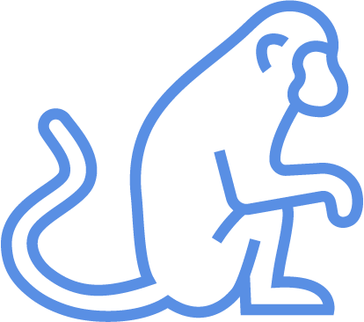
Welcoming breath
Thank the monkey
Create some “good” stress
More Ways to Tame the Monkey
Notes:
When we apply expansion strategies, we’re likely to experience more anxious feelings. Here are three tools we can use to manage those feelings.
Welcoming breath: The next time you feel anxious, pause and notice where the discomfort is strongest—chest, stomach, head, or anywhere else. Then, start breathing intentionally into that spot, imagining each breath as a calm, welcoming wave of air.
This “Welcoming Breath” invites discomfort without resistance, helping create a mindset of acceptance. Breathe deeply, letting each inhale open space for the feeling and each exhale release any need to control it. If the feeling shifts or intensifies, keep welcoming it. Even if more anxious thoughts arise, just refocus on your breath, inviting each sensation without judgment. Remember, building resilience through this practice takes time. Each time you welcome an anxious feeling instead of resisting it, you’re strengthening your ability to handle discomfort and growing more adaptable.
Thank the monkey: To let the monkey know, “I hear your chatter, and I can handle it,” give it full voice. But giving the monkey full voice doesn’t mean following its lead. Just notice the chatter without judging or reacting, like hearing an airport announcement at the airport warning you not to leave your baggage unattended. No matter how repetitive or troubling the monkey chatter is, keep noticing it—again and again.
By noticing, you allow yourself to have those negative thoughts without treating them as a call to action. You create distance between you and the monkey, becoming an observer rather than a participant in its chatter. When the monkey gets loud, simply observe the thought and move on. Acknowledge the monkey with a polite “thank you”—it’s just trying to keep you safe. Like a tantrum-­throwing toddler, the monkey will not be quieted with reason. Repeating this practice strengthens your ability to let go, helping you override the monkey’s demands and stay focused on your goals, no matter how loud it gets.
And the last tool we’ll cover is “Create some good stress” in your life. Wait—good stress? Let’s see what that’s all about.

Slide 32



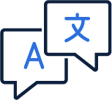


Learn Something New
Try different physical activities
Learn a new song to sing or play
Try your hand at a new language
Read a book on a subject you’re not familiar with
Socialize with friends and meet new people
Create Some “Good” Stress
Notes:
Let’s dig into this idea of good stress some more. Another effective way to help manage anxiety—and tame the monkey—is to create the right kind of stress. Research shows that some stress can actually reduce anxiety and be good for the brain. Psychologists call this the Yerkes-Dodson curve. It shows that performance suffers at both extremes—too much anxiety can paralyze us, while too little can make us careless. But in the middle, there’s a sweet spot where moderate stress helps us focus, stay motivated, and take purposeful action.
Instead of aiming for a stress-free life, try embracing meaningful challenges that stretch us—learning a new skill, tackling a project, or trying something unfamiliar. These experiences create short bursts of good stress that retrain the monkey mind to tolerate discomfort and reduce anxiety over time. They also build confidence and resilience, which makes future stress feel less threatening.
That’s why this slide lists ideas like learning a new language, trying a new activity, or meeting new people. Think of these as small, intentional steps that help calm anxiety and expand our world. Keeping the brain sharp is a nice bonus.
Now, let’s pull everything together with a quick summary of what we’ve learned so far.

Slide 33

Summary
What Is the Monkey Mind? Always screening for threats
The Cost of Anxiety Choose safety or personal values
Taming the Monkey Replacing safety strategies with expansion strategies
Notes:
To summarize…(read slide)

Slide 34
The Bottom Line
When you control your response to the monkey, it loses its control over you.
Jennifer Shannon
Notes:
This quote is a great reminder that managing anxiety doesn’t require perfection—just a different response. When we notice the monkey mind without obeying it, we loosen its grip and create space to act on what matters. The more we practice these small shifts, the less power anxiety has over our choices, our relationships, our health, and our finances.

Slide 35
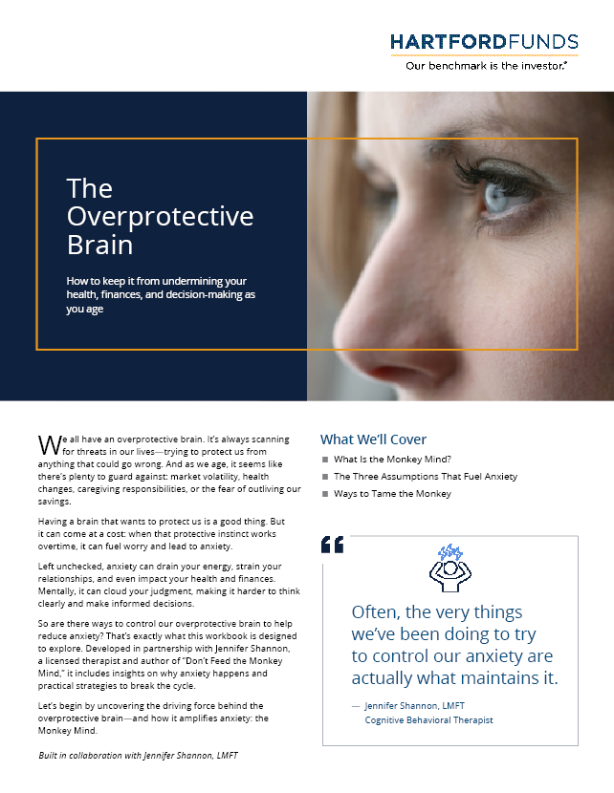
Next Steps
This week, choose one tool to try—expansion strategy, welcoming breath, or thanking the monkey
Over the next month, notice when anxiety flares and the monkey chatters
Apply the tool you chose to calm anxiety and tame the monkey
Hartford Funds Distributors, LLC, Member FINRA.
The views and opinions expressed herein are those of the author, who is not affiliated with Hartford Funds.
The information provided in this presentation is for educational and informational purposes only. If you have questions or concerns about anxiety disorders or other aspects of this presentation, please consult a licensed mental health professional.
Investing involves risk, including the possible loss of principal.
SEM_Overprotect 5356774 0426
MAI465
Notes:
As you head into the week, think of today’s session as a starting point. You don’t need to use every tool—just pick one to practice, whether it’s an expansion strategy, a Welcoming Breath, or simply thanking the monkey before reacting.
Over the next month, notice when the monkey chatter pops up and use those moments to try your chosen tool.
And before you go, make sure to grab the workbook—it recaps everything we covered today and includes all the action steps we discussed. These small shifts can make a meaningful difference in your confidence, well‑being, and finances.

