Slide 1

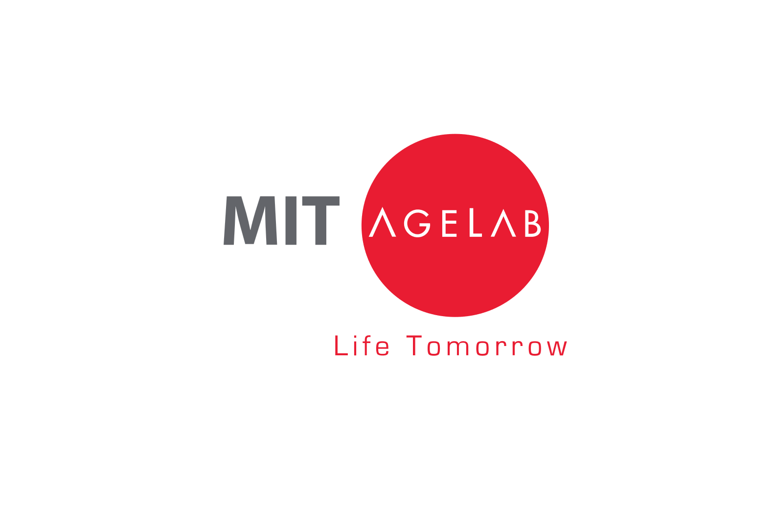
Maintaining Perspective
in Uncertain Times
Notes:
Good morning/afternoon everyone. My name is __________, and I’m a [insert title] with Hartford Funds. Thank you for taking time out of your schedule to attend our event.
Today, we’re going to talk about maintaining perspective during uncertain times. To help guide our conversation, we’ll be drawing on insights from the Massachusetts Institute of Technology, or MIT.
Within MIT is a research center called the AgeLab. The AgeLab explores how people think, act, and make decisions—especially under stress or during periods of crisis. For today’s discussion, we’ll look at how their findings can help us better understand the behavioral tendencies that may influence our choices, and how we can avoid common decision-making pitfalls when uncertainty is high.

Slide 2

Multidisciplinary research program that works with business, government, and non-government organizations
Seeks to understand longevity challenges and opportunities
Invents solutions enabling people to do more throughout their lives
Aims to improve quality of life for older people and those who care for them
Notes:
Before we jump into the content, I want to spend just a minute on who the MIT AgeLab is and why their work matters.
The AgeLab is part of MIT’s School of Engineering, but it pulls in experts from across the university—everything from management and architecture to social sciences. Their focus is really practical: understanding how longer lives are changing the way people live, work, and make decisions, and then turning that insight into solutions that actually help people function better as they age.
They study how people think, behave, and adapt across different life stages—and those insights are especially valuable in financial services, where longer lifespans are reshaping planning, priorities, and expectations.
At the heart of their work is a simple idea: we’re living longer than any generation before us. That ‘longevity bonus’ comes with huge opportunities—but it also requires new ways of thinking about life, health, and money.
2

Slide 3

Agenda
Agenda
Stress, Anxiety, and Crises
Instinctual Behavior
Maintaining Perspective
Notes:
Here are three areas we’ll consider [read slide]
3

Slide 4

Stress, Anxiety, and Crises
Copyright © 2024 by Hartford Funds.
Notes:
Let’s begin with our analysis in the first area: Stress, Anxiety, and Crises

Slide 5
Stress: Anything that disrupts homeostasis
Fear: Clear or present danger
Anxiety: Anticipation of a clear or present danger, whether real or not
Notes:
Stress is anything that disrupts normalcy or homeostasis in a typical day
Fear is a clear and present danger that needs to be dealt with.
Although fear and anxiety are often used interchangeably, they're two different things
Anxiety: It’s a fear of fear, or anticipation of fear based on feelings and emotions. It could translate to the fear of something that doesn't exist.
Examples:
Imagine you’re walking down the sidewalk and, unexpectedly, a snake slithers out of the bushes and stops about ten feet in front of you. That sudden disruption to your day is stress—something has interrupted normal conditions.
The snake itself represents a clear and present danger, triggering fear. Fear is an immediate response. Your heart rate increases, adrenaline kicks in, and you instinctively move out of harm’s way.
Anxiety shows up later.
Anxiety is what happens when, days or weeks afterward, you refuse to walk down that same sidewalk—not because a snake is there now, but because one might be. The danger is no longer present, but the anticipation of danger remains.
That distinction matters.
In investing, a real market event can create fear in the moment. But long after the event has passed, anxiety can linger. And that’s often when investors begin making decisions based more on emotion and anticipation than on facts and fundamentals.
(Note: Homeostasis, from the Greek words for "same" and "steady," refers to any process that living things use to actively maintain fairly stable conditions necessary for survival.)

Slide 6
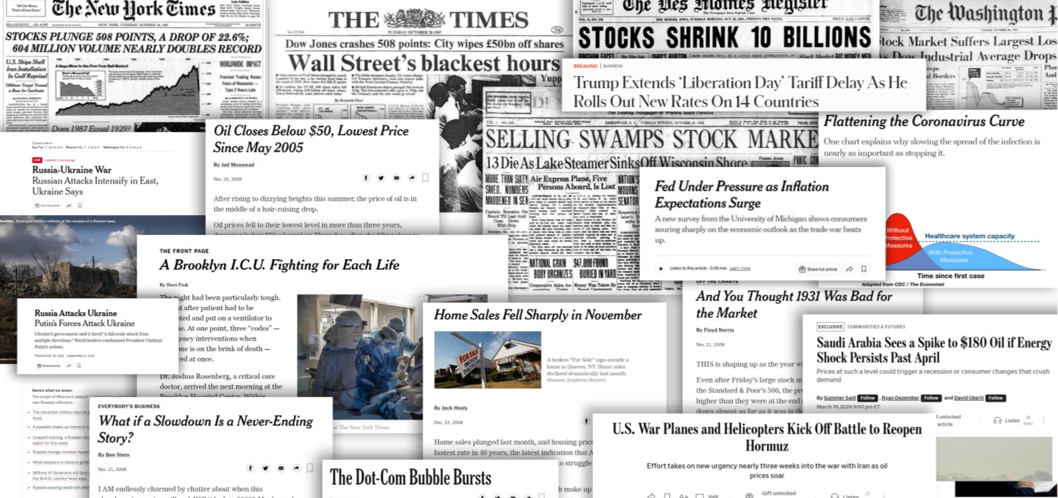
CRISIS!
Notes:
All the emotions we just discussed are amplified by the world we live in today—a world dominated by constant crises, breaking news alerts, and nonstop notifications.

Slide 7
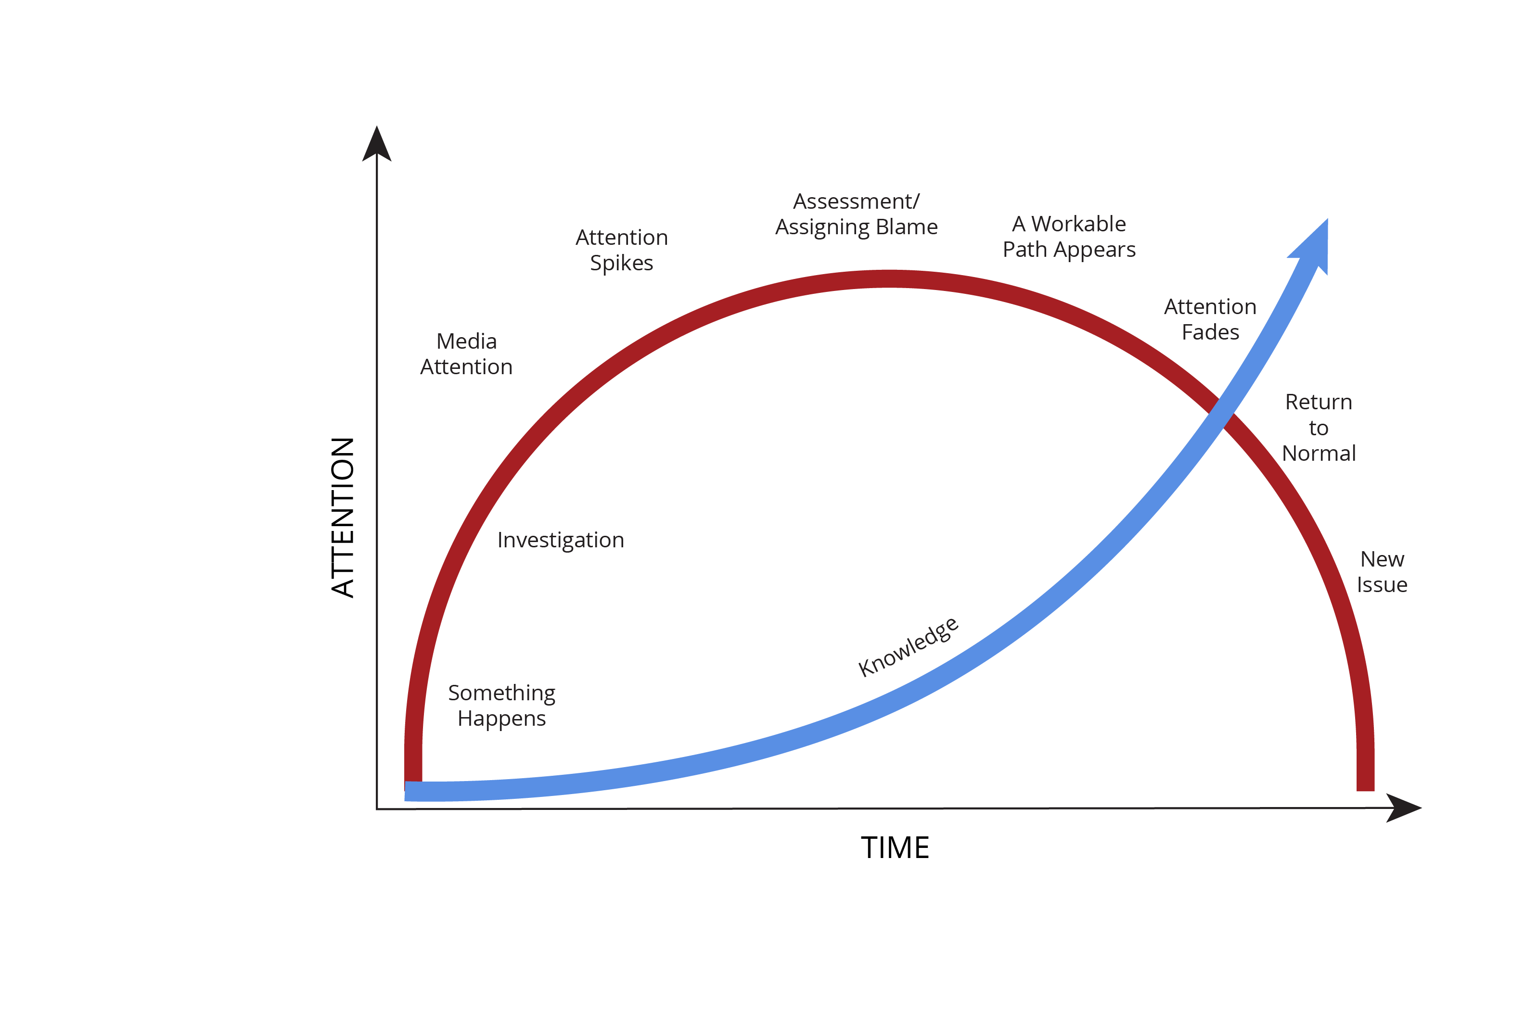
Issue
Lifecycle
Source: MIT AgeLab
Notes:
When a crisis hits, attention spikes fast—especially when headlines are loud and facts are scarce. That early phase can feel intense because we’re reacting before the full story is known. The MIT AgeLab’s Issue Lifecycle shows that crises often follow a similar pattern: attention peaks early, then fades as information surfaces, workable options emerge, and a newer concern takes its place.
Discuss the lifecycle of an issue. [read slide]
At first, things are normal—no one’s really paying attention.
Then something happens, and people start investigating.
Media picks it up, and attention spikes.
The main event hits—everyone’s watching.
Different groups jump in: government, public, interest groups.
People start pointing fingers—was it a system failure or someone’s fault?
Congress might hold hearings, and symbolic actions like commissions happen.
Eventually, we get some policy changes or reports.
Then attention fades, and we settle into a new normal.

Slide 8

Instinctual Behavior
Notes:
Next, let’s move on to Instinctual Behavior

Slide 9


Anxiety’s Impact on Behavior
Investing attention in the negative
If it’s not clear, it must be bad
Risk aversion: “Just don’t lose it!”
Notes:
Insights from Dr. Joseph Coughlin, Founder and Director, MIT AgeLab
These findings are drawn from Dr. Coughlin’s research on how anxiety influences the way people think, process information, and make decisions—especially during periods of stress or uncertainty. In investing, elevated anxiety can subtly shift behavior in ways that feel protective in the moment but often work against long‑term goals.
Investing Attention in the Negative
Anxious investors are more apt to devote their attention to information that is negative.
When faced with the choice between information that could potentially inspire optimism versus information that paints a dismal future, the anxious client will opt to focus on the latter.
If It’s Not Clear, It Must be Bad
To further complicate matters, anxious investors process ambiguous information differently. Information that isn’t crystal clear is more likely to be perceived as bad or even threatening, fueling their pessimism.
Risk Aversion: “Just Don’t Lose It!”
Today’s investor is more likely to say, “Just don’t lose it!” rather than, “How do we grow it?”
An anxious investor’s main objective is to reduce current risk—not to plan ahead. Instead of making decisions based on long-term financial objectives, they will act upon how they feel in the moment.

Slide 10
Investing Attention
In The Negative
Google Searches for “CNBC” vs. S&P 500 Index
Google searches for CNBC¹
S&P 500 Index²
2025
PAST PERFORMANCE DOES NOT GUARANTEE FUTURE RESULTS. Indices are unmanaged and not available for direct investment. For Illustrative purposes only.
Google Trends Methodology: Google Trends enables you to compare the world’s interest in various internet topics; it shows how frequently topics have been searched on Google over time. The numbers on the graph reflect how many searches have been done for a particular term, relative to the total number of searches done on Google over time. They don’t represent absolute search volume numbers, because the data is normalized and presented on a scale from 0-100. Each point on the graph is divided by the highest point, or 100. A rising line for a search term indicates a growth in the term’s popularity.
¹Data Source: Google Trends, 2026; ²Data Source: FactSet, 2026. Index descriptions are included on last slide.
Notes:
This graph shows a repeating pattern that surfaces in almost every crisis.
When something big and unsettling happens in the world, look at what the red line does. Google searches for ‘CNBC’ suddenly spike. It’s a real‑time indicator of investor anxiety—people are trying to make sense of what’s happening, they’re worried about their money, and they want immediate answers.
And those spikes line up almost perfectly with major disruptions.
You can see them during events like the 2008 financial crisis, the 2011 U.S. credit downgrade, the 2020 COVID shock, and even the tariff escalation in 2025. Each disruption triggers the same instinctual behavior: attention narrows, fear rises, and we rush toward news that makes us feel more ‘in the know,’ even if it doesn’t necessarily help us make better decisions.
But here’s the part we can’t afford to overlook.
Notice what the blue line—the S&P 500—does over time. Yes, it dips during those stressful moments. Yes, it can feel scary in real time. But when you zoom out and look across decades, a different picture emerges: The long‑term trend is surprisingly steady—from lower left to upper right.
That contrast is the whole point of this slide.
Our emotions operate on a short-term timeline. Markets reward a long‑term one. We tend to invest our attention in the negative, but the market’s long‑term story has been one of resilience, recovery, and growth.
Example:
In early April 2025, tariffs were first announced following market close on April 2, and markets reacted imminently. The S&P 500 fell about 11% over the next two trading days (April 3 & 4) as the scope of the tariff plan expanded and reciprocal rates were added—well beyond what investors expected.* Fear surged, volatility spiked, and it became one of the sharpest short-term declines in decades.
But then the script flipped.
On April 9, the administration dialed back most of the new tariffs with a 90‑day pause for many countries, and markets snapped back—the S&P 500 jumped nearly 10% that day, and by month‑end had recovered most of the early‑April drawdown.* Investors who panicked and shifted to “safer” assets locked in losses—then missed the rapid rebound just a week later.
The recovery didn’t stop there. From the April 8 low to year‑end 2025, the S&P 500 rose about 39%, finishing 2025 up roughly 18% return—an expensive detour for anyone who went “safe” during the tariff scare and sat out the upswing.*
*Source: Morningstar, 2026

Slide 11
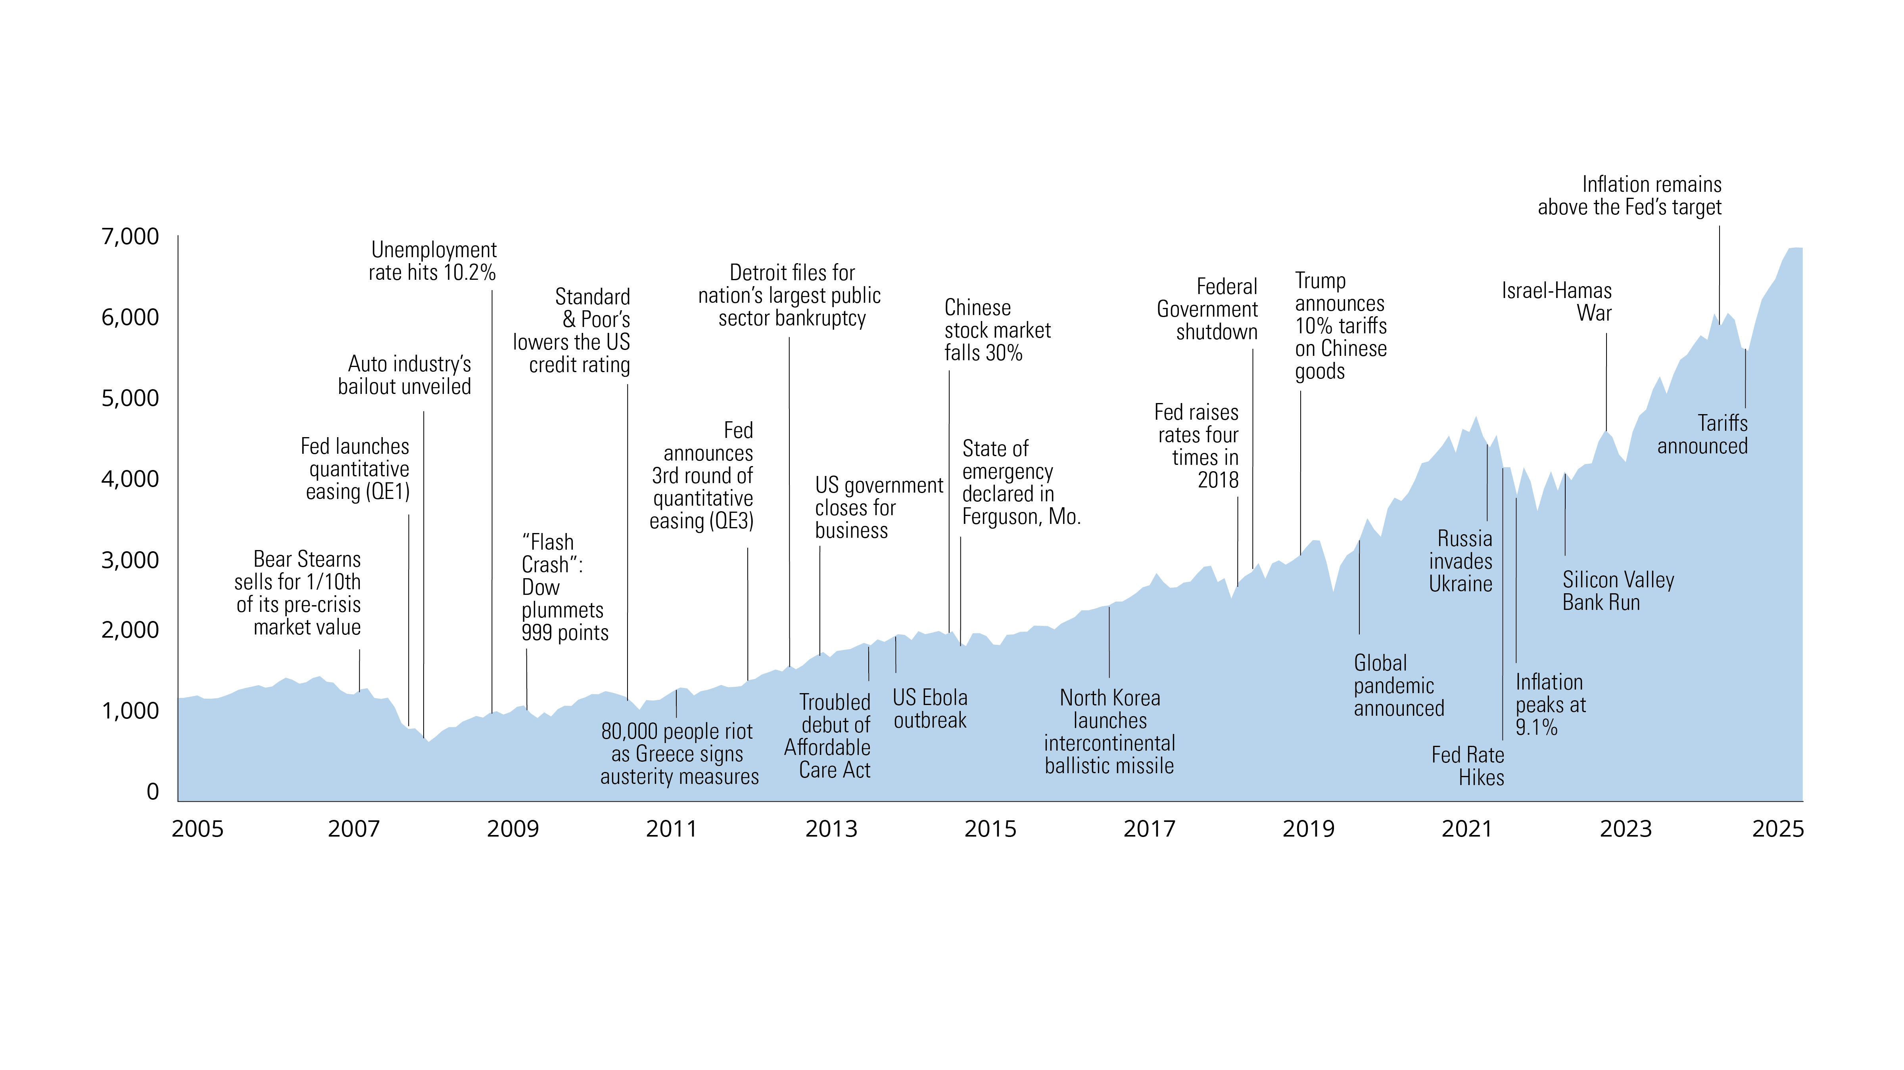
If It’s Not Clear, It Must Be Bad
S&P 500 Index
Source: FactSet 2026
PAST PERFORMANCE DOES NOT GUARANTEE FUTURE RESULTS
For Illustrative purposes only.
S&P 500 Index
Notes:
The second insight from the MIT AgeLab about how anxiety affects our behavior is “If It’s Not Clear, It Must Be Bad.” When people feel anxious, ambiguity doesn’t feel neutral—it feels threatening. Anything unclear or not fully explained tends to be interpreted in the most negative way possible.
You can see this clearly when major crises hit. Take the global pandemic. In those first days and weeks, no one knew what was happening, how serious it was, or how long it would last. That total ambiguity magnified the fear dramatically. The crisis itself was genuinely bad—but the uncertainty made it feel even worse, driving investors to brace for the worst before the facts were even known.
That’s the real point behind this insight: ambiguity intensifies anxiety. When details conflict, headlines shift by the hour, and information is incomplete, the brain instinctively assumes danger. During fast‑moving events like the ones shown on this chart, that heightened sense of threat pushes investors toward pessimism and short‑term reactions that often work against them.
This slide highlights nearly two decades of those confusing, fast‑moving events. Each crisis created a period of unclear information and heightened anxiety—yet despite all that, markets eventually recovered and moved higher.
Even though a chart like this makes it clear that markets tend to rise over the long term, even through crises, what investors feel in the short term is very different. When a crisis hits and information is unclear, ambiguity and anxiety spike, and markets often drop sharply. In those moments, people naturally start thinking, “I just need to stop losing money.”
Next, let’s take a look at why that perception can be so powerful—and how it drives instinctive behavior.

Slide 12

Risk Aversion: Just Don’t Lose It
The frustration
losing money is
2 3x
stronger than the
pleasure of gaining it
TO
Source: Kahneman, D., Knetsch, J. L., & Thaler, R. H. (1991).“Loss Aversion in Riskless Choice: A Reference-Dependent Model.”Quarterly Journal of Economics, 106(4), 1039–1061.
Notes:
The third insight from the MIT AgeLab is risk aversion, summed up in the phrase: “Just don’t lose it!” When anxiety rises, our natural instinct isn’t to think about growth—it’s to protect what we already have. Avoiding loss suddenly feels far more important than pursuing gains.
Here’s a simple example. Imagine you find a $20 bill on the sidewalk. That feels good. But if you lose that same $20 ten minutes later, the frustration is two to three times stronger than the pleasure of finding it. The net result is the same—you’re back where you started—but it doesn’t feel the same. This tendency, known as loss aversion, reflects how the pain of losing typically outweighs the emotional impact of gaining.
This is exactly what happens during market uncertainty. When ambiguity rises—like in the crises we just reviewed—investors often shift into loss‑prevention mode. The instinct becomes: “Just don’t lose my money.”
And that instinct is powerful enough to override long‑term strategy. Instead of thinking about goals or future growth, many investors move into cash, sell during downturns, or avoid equities altogether simply because the threat of loss feels too big to tolerate.
That’s why risk aversion matters for investing: If avoiding loss becomes the top priority, it can pull investors out of the market at the worst possible moments—and cause them to miss the recovery that follows.
This sets up the next slide: what happens when fear of loss blinds us to long‑term growth opportunities.

Slide 13
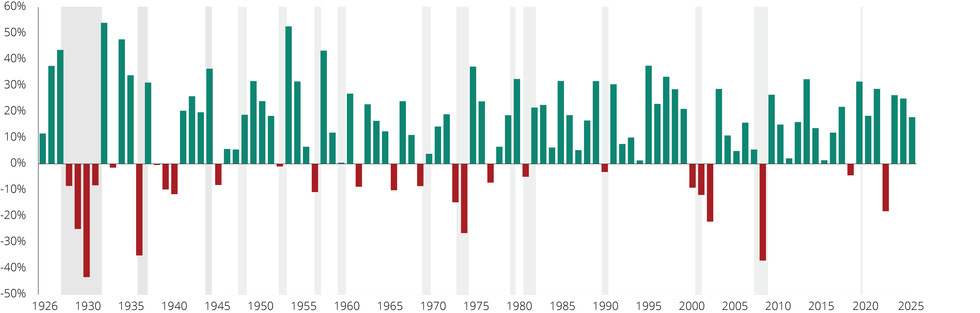
Is Fear of Loss Keeping You From Growth Opportunities?
Average Annual Returns (S&P 500 Index 1926–2025)
Recessions
PAST PERFORMANCE DOES NOT GUARANTEE FUTURE RESULTS. Source: Morningstar, 2026.
Notes:
We’ve just explored how loss aversion works—how the pain of loss weighs more heavily on us than the pleasure of gains. This slide shows how that instinct shows up in our investing decisions.
Let me ask you a question: When you look at this chart, which color do you see more—green or red?
Green, right?
There are 74 green bars representing positive years for the S&P 500… and 26 red bars representing negative years.
So looking at this, it can make the answer seem obvious: stocks—the S&P 500—have been a powerful engine for long‑term growth. On paper, it feels like a no‑brainer.
But in real time, it’s easier said than done.
Think about a couple of those red years—2008 during the Great Recession, or 2020 during the global pandemic. Living through those moments felt dramatically different from just seeing a red bar on a chart. The uncertainty, the steady stream of negative headlines, the daily drops—they didn’t just create fear.
They created a very real temptation to act:
to move to cash, shift into “safer” investments, or step out of the market entirely in hopes of stopping the emotional discomfort of watching balances go down.
And that’s the influence of loss aversion. Even though history shows far more green years than red, the emotional impact of those painful years can shape how people feel about investing well after the event is over. The fear becomes a stronger influence than the historical pattern.
That’s why this slide matters: the years that hurt the most don’t just shape how we remember the past—they shape how we behave in the future.
Now let’s take this one step further. If this is the year‑by‑year record, what does the scoreboard of all these years together look like? The next slide lays it out clearly.

Slide 14

S&P 500 Index Stats (1926-2025)
POSITIVE |  | NEGATIVE
Number of Positive Years: | 74 | Number of Negative Years: | 26
Percentage of Positive Years: | 74% | Percentage of Negative Years: | 26%
Number of Years When Gains Were Greater Than 20%: | 38 | Number of Years When Losses Were Greater Than 20%: | 6
AVERAGE ANNUAL RETURN: 10.5%
Source: Morningstar, 2026
PAST PERFORMANCE DOES NOT GUARANTEE FUTURE RESULTS. Indices are unmanaged and not available for direct investment. Source: Morningstar, 12/23
Copyright © 2024 by Hartford Funds.
Notes:
If the last slide showed the year‑by‑year play‑by‑play, this slide is the scoreboard. Nearly a century of market history summarized in one view:
74 positive years
26 negative years
38 years with gains over 20%
Only 6 years with losses over 20%
A long‑term average return of 10.5%
Based on the scoreboard alone, it may look obvious why long‑term investors often turn to stocks for growth. The historical record heavily leans green.
But here’s the reality:
Even with a scoreboard like this, many investors struggle to actually experience those long‑term returns.
Why? Because the three MIT AgeLab insights explain how anxiety can derail even the best long‑term intentions:
We focus on the negative.
Negative headlines and downturns feel more urgent than long stretches of positive years.
Ambiguity amplifies fear.
When information is unclear during crises, anxiety spikes and confidence drops.
Losses feel more painful than gains feel good.
That emotional imbalance naturally pushes investors toward caution, especially after sharp declines.
Those instincts are normal—but they make it harder to stay invested consistently enough to capture the long‑term results this scoreboard reflects.
And that’s really the value of this scoreboard: it shows what’s possible over the long term. But actually capturing those results requires keeping perspective through uncertainty. So in our last section, let’s talk about how to do exactly that.

Slide 15
Maintaining Perspective
Notes:
Finally, let’s discuss our last section: Maintaining Perspective

Slide 16

How to Maintain Perspective
Don’t overlook the positive
Have a plan
Volatility should be expected
Notes:
These three practices can help counter the instinctual behaviors we talked about earlier:
Don’t Overlook the Positive
In uncertain times, negative news dominates, making it easy to overlook the positive developments happening in the background.
Have a Plan
A clear plan can help anchor decisions when markets become stressful or unpredictable.
Expect Volatility
Ups and downs are normal. Expecting them can help reduce the urge to react emotionally.
With those principles in mind, let’s look at some long‑term positive trends that often get overshadowed during periods of uncertainty.

Slide 17


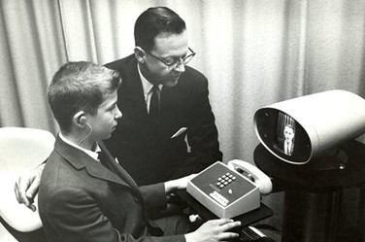
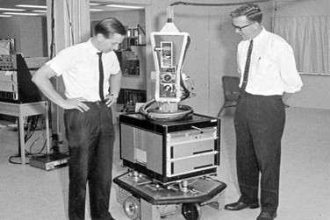
Don’t Overlook the Positive: The Power of Patience
Electric cars
iPhone
Video conferencing calls
AI
Notes:
The first way to maintain perspective during uncertain times is simple: Don’t overlook the positive.
Big innovations often take decades to develop before they suddenly gain traction. You never know when that moment will come—but when it does, it can have a tremendous impact and help drive markets higher.
Electric cars—long before Tesla, early electric vehicles were already on the roads in the late 1800s.
AI—the concept and the term “artificial intelligence” emerged in the 1950s–1960s.
Video conferencing—early demonstrations go back to 1927, with AT&T’s Picturephone debuting in 1964, but widespread adoption didn’t happen until the 2020 pandemic era.
Apple’s evolution—Apple was founded in 1976, introduced the iPod in 2001, and the iPhone arrived in 2007 after decades of iteration.
Sometimes, the biggest breakthroughs come after long periods of doubt or downturn.
Let’s look at some of the positive innovations unfolding right now that often get overshadowed during periods of uncertainty.

Slide 18




Don’t Overlook the Positive: Innovation Doesn’t Stop
Scaling Up the Future of Air Travel
Blood Tests Catch Problems Earlier
A Smarter Kind of Helper for the Home
AI Helpers That Make Everyday Life Easier
Notes:
Even when uncertainty dominates the headlines, meaningful innovation continues behind the scenes. These breakthroughs often build quietly for years before suddenly reshaping everyday life—and markets.
Scaling Up the Future of Air Travel
Electric air‑taxi technology is moving toward real production, with companies expanding facilities and working toward certification. It’s early, but it signals real progress toward short, on‑demand urban flights.
Source: Air taxi maker Joby buys new Ohio factory, more than doubles manufacturing footprint as it vies for FAA approval, CNBC, 1/7/26
Blood Tests Catch Problems Earlier
Wouldn’t it be nice to spot health problems before they get serious? Newly developed AI blood tests can screen for multiple cancers and other conditions from one sample. Early detection saves lives—and with access expanding rapidly, these once‑advanced tools are becoming far more affordable to use.
Source: Mayo Clinic AI Tool Finds Early Signs of Blood Mutations Linked to Cancer and Heart Disease, Mayo Clinic, 7/30/25
A Smarter Kind of Helper for the Home
Tesla’s Optimus is being designed to learn the world the way people do—seeing, understanding, and adapting to new situations. As production scales, the goal is clear: a home robot that can take on everyday chores like dishes, laundry, and tidying, without needing everything pre‑programmed.
Source: Is China About To “BYD” Tesla’s Humanoid Dreams? Forbes, 2/20/26
AI Helpers That Make Everyday Life Easier
I’m not going to tell you that any technology is all good or all bad—and the same is true of AI. But if we focus on how it can genuinely help for a moment, new digital tools are emerging that can assist older adults with everyday tasks like organizing information, keeping track of important documents, or spotting potential fraud. These are practical, day‑to‑day benefits designed to make life a little easier.
Source: Older Adults Want AI to Show Up in Practical Ways, AARP, 1/13/26
Next, let’s look at what can happen to our investment returns if we focus too much on the negative and not as much on the positive.

Slide 19
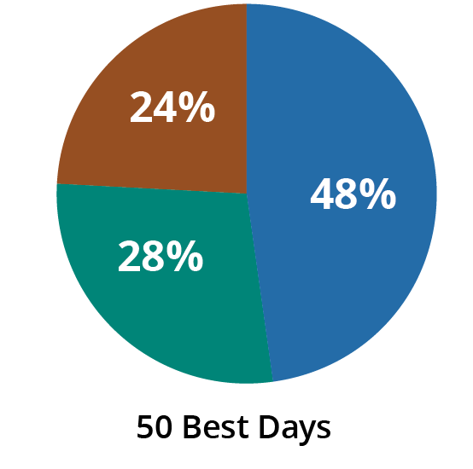
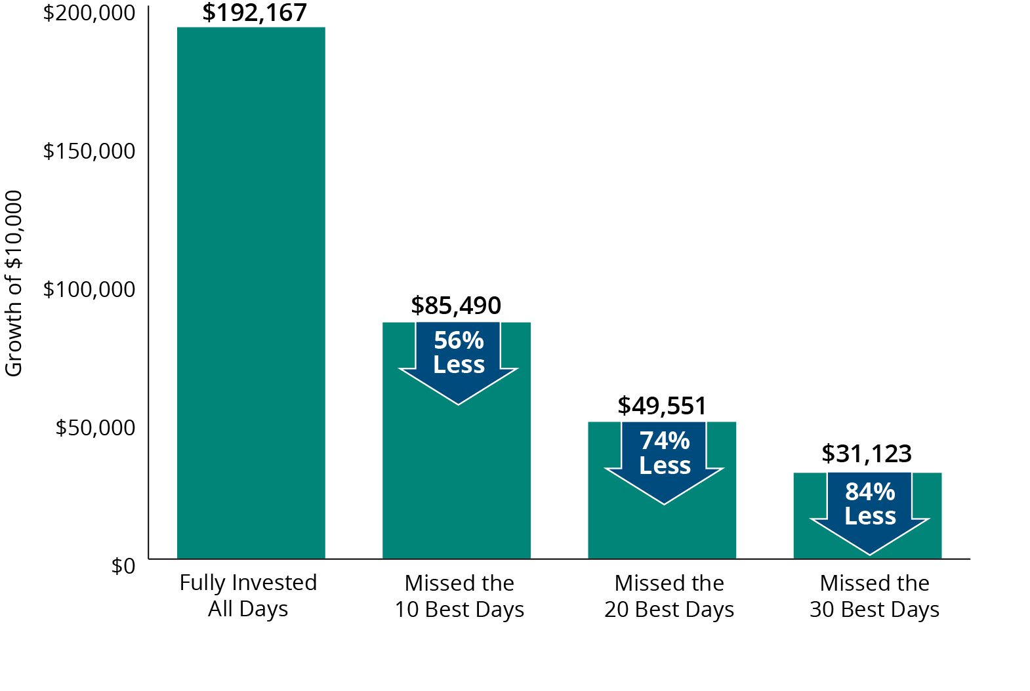
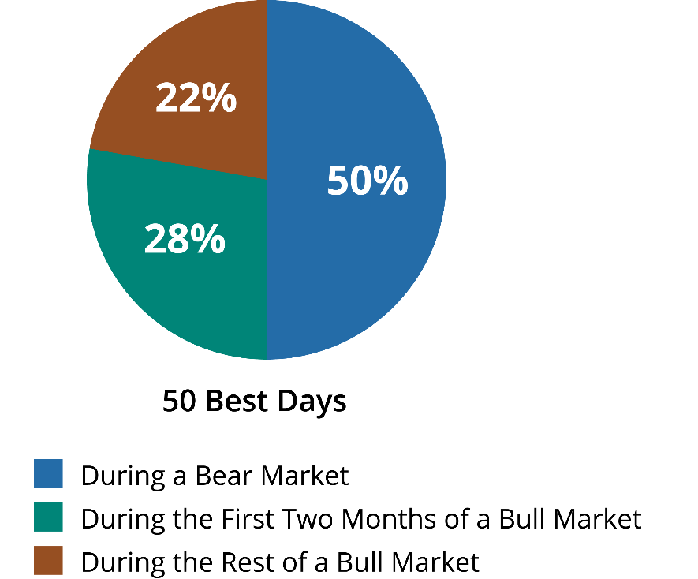
Have a Plan: Why Staying Invested Matters
Good Days Happen in Bad Markets
S&P 500 Index Best Days (1996–2025)
Missing the Market’s Best Days Has Been Costly
S&P 500 Index Average Annual Total Returns (1996–2025)
For illustrative purposes only. Data sources: Ned Davis Research, 2026
Past performance does not guarantee future results. For illustrative purposes only.
Data Sources: Ned Davis Research and Morningstar, 2026
Notes:
The second way to maintain perspective during uncertain times: Have a plan.
This slide has two separate charts, so let’s walk through them one at a time.
Left Chart—“Good Days Happen in Bad Markets”
During a bear market, it’s completely natural for investors to want to move toward “safer” investments to stop the losses. That instinct makes perfect sense in the moment.
But what surprises most people is this: many of the best days in the market actually occur during or just as they’re starting to recover.
This chart highlights that pattern—strong positive days often show up when confidence is lowest. And without a plan in place, those days are easy to miss.
Right Chart—“Missing the Market’s Best Days Has Been Costly”
The second chart speaks to another very human reaction: when markets fall sharply, the instinct is to get out of equities and wait for things to feel more stable.
But stepping out—even temporarily—can mean missing just a handful of those powerful rebound days we saw on the left side. And missing even a few of them can dramatically reduce long‑term returns.
A plan helps temper that instinct—so decisions are guided by strategy rather than stress.
Let’s build on that idea by looking at why a diversified approach can help create steadier experiences through all kinds of market environments.

Slide 20
Have a Plan:
Annual Percentage Returns by Asset Class (%) (2012–2025)
Average
Return For
All Periods
BEST
2012 | 2013 | 2014 | 2015 | 2016 | 2017 | 2018 | 2019 | 2020 | 2021 | 2022 | 2023 | 2024 | 2025
18.22 Emerging Markets | 38.82 Small-Cap Stocks | 13.45 Large-Cap Value | 5.67 Large-Cap Growth | 21.31 Small-Cap Stocks | 37.28 Emerging Markets | 1.82 Cash | 36.39 Large-Cap Growth | 38.49 Large-Cap Growth | 27.60 Large-Cap Growth | 1.52 Cash | 42.68 Large-Cap Growth | 33.36 Large-Cap Growth | 33.57 Emerging Markets |  | 19.37 Large-Cap Growth
17.51 Large-Cap Value | 34.76 Mid-Cap Stocks | 13.22 Mid-Cap Stocks | 0.65 Short Duration | 17.34 Large-Cap Value | 30.21 Large-Cap Growth | 1.60 Short Duration | 30.54 Mid-Cap Stocks | 19.96 Small-Cap Stocks | 25.16 Large-Cap Value | -3.69 Short Duration | 18.24 Int’l Equities | 15.34 Mid-Cap Stocks | 31.22 Int’l Equities |  | 13.01 Mid-Cap Stocks
17.32 Int’l Equities | 33.48 Large-Cap Growth | 13.05 Large-Cap Growth | 0.55 Core Bonds | 13.80 Mid-Cap Stocks | 25.03 Int’l Equities | 0.01 Core Bonds | 26.54 Large-Cap Value | 18.31 Emerging Markets | 22.58 Mid-Cap Stocks | -7.54 Large-Cap Value | 17.23 Mid-Cap Stocks | 14.37 Large-Cap Value | 18.56 Large-Cap Growth |  | 12.22 Large-Cap Value
17.28 Mid-Cap Stocks | 32.53 Large-Cap Value | 5.97 Core Bonds | 0.03 Cash | 11.19 Emerging Markets | 18.52 Mid-Cap Stocks | -1.51 Large-Cap Growth | 25.52 Small-Cap Stocks | 17.10 Mid-Cap Stocks | 14.82 Small-Cap Stocks | -13.01 Core Bonds | 16.93 Small-Cap Stocks | 11.54 Small-Cap Stocks | 16.91 Diversified Portfolio |  | 11.55 Small-Cap Stocks
16.35 Small-Cap Stocks | 22.78 Int’l Equities | 5.53 Diversified Portfolio | -0.81 Int’l Equities | 9.46 Diversified Portfolio | 17.97 Diversified Portfolio | -7.08 Diversified Portfolio | 22.01 Int’l Equities | 14.41 Diversified Portfolio | 12.11 Diversified Portfolio | -14.45 Int’l Equities | 15.81 Diversified Portfolio | 11.44 Diversified Portfolio | 15.91 Large-Cap Value |  | 9.51 Diversified Portfolio
15.26 Large-Cap Growth | 19.80 Diversified Portfolio | 4.89 Small-Cap Stocks | -2.44 Diversified Portfolio | 7.08 Large-Cap Growth | 14.65 Small-Cap Stocks | -8.27 Large-Cap Value | 21.52 Diversified Portfolio | 7.82 Int’l Equities | 11.26 Int’l Equities | -15.71 Diversified Portfolio | 11.46 Large-Cap Value | 7.50 Emerging Markets | 12.81 Small-Cap Stocks |  | 9.04 Int’l Equities
13.43 Diversified Portfolio | 0.64 Short Duration | 0.77 Short Duration | -2.44 Mid-Cap Stocks | 2.65 Core Bonds | 13.66 Large-Cap Value | -9.06 Mid-Cap Stocks | 18.44 Emerging Markets | 7.51 Core Bonds | 0.04 Cash | -17.32 Mid-Cap Stocks | 9.83 Emerging Markets | 5.32 Cash | 10.60 Mid-Cap Stocks |  | 6.96 Emerging Markets
4.21 Core Bonds | 0.05 Cash | 0.02 Cash | -3.83 Large-Cap Value | 1.28 Short Duration | 3.54 Core Bonds | -11.01 Small-Cap Stocks | 8.72 Core Bonds | 3.33 Short Duration | -0.47 Short Duration | -20.09 Emerging Markets | 5.53 Core Bonds | 4.36 Short Duration | 7.30 Core Bonds |  | 2.19 Core Bonds
1.26 Short Duration | -2.02 Core Bonds | -2.19 Emerging Markets | -4.41 Small-Cap Stocks | 1.00 Int’l Equities | 0.84 Short Duration | -13.79 Int’l Equities | 4.03 Short Duration | 2.80 Large-Cap Value | -1.54 Core Bonds | -20.44 Small-Cap Stocks | 5.14 Cash | 3.82 Int’l Equities | 5.35 Short Duration |  | 1.76 Short Duration
0.08 Cash | -2.60 Emerging Markets | -4.90 Int’l Equities | -14.92 Emerging Markets | 0.26 Cash | 0.82 Cash | -14.58 Emerging Markets | 2.21 Cash | 0.54 Cash | -2.54 Emerging Markets | -29.14 Large-Cap Growth | 4.61 Short Duration | 1.25 Core Bonds | 4.29 Cash |  | 1.58 Cash
WORST
As of 12/31/25. Past performance does not guarantee future results. Indices are unmanaged and not available for direct investment. Diversification does not ensure a profit or protect against a loss. Source: Morningstar, 2026. See last slide for representative indices and their definitions.
Notes:
When markets feel uncertain, it’s easy to think the answer is simply avoiding downturns. But there’s a flip side that trips investors up just as often: chasing winners—always trying to pile into whatever was hot last year.
This chart makes the problem visible. Leaders rotate. The “top” box one year often doesn’t stay there—and it’s common to see yesterday’s winner drift toward the bottom in later years. Predicting the next leader is hard; reacting to the last one is even harder.
Question for the room:
When you look at this, do any boxes stand out?
Most people point to the white boxes—steady, never at the very top, but importantly not at the bottom either. That white row represents a diversified mix.
Bottom line: Diversification doesn’t eliminate ups and downs, but it reduces the need to guess which box will win next and helps smooth the experience so you’re not constantly jumping from last year’s leader to tomorrow’s laggard.
Now that we’ve covered why a plan and diversification matter, let’s level‑set expectations—volatility is normal—and look at what large market drops have looked like over time.

Slide 21
Volatility Should Be Expected: Resist the Temptation to Panic
30%+ Drops in the S&P 500 Index (1960–2025)
-36.1%
11/29/68-5/26/70
Interest rates rose above 9%
Vietnam War
-- -48.2%
1/11/73-10/3/74
Middle East oil embargo
Watergate
-33.5%
8/25/87-
12/4/87
Black Monday: the Dow Jones Industrial Average dropped 22%
in a single day
-36.8%
3/24/00-
9/21/01
Dot-com bubble
Accounting scandals
9/11
-33.8%
1/4/02-10/9/02
WorldCom collapse
Tyco executives indicted
Ford closes five plants
-56.8%
10/9/07-3/9/09
Housing bubble
Financial crisis
-33.9%
2/19/20-3/23/20
Global pandemic
Source: Ned Davis Research, 2026
Notes:
Volatility is part of long‑term investing. But when the market plunges 30% or more, it doesn’t feel “normal”—it feels like free‑fall. Screens go red, headlines escalate, and there’s a powerful urge to “do something” to protect your investments—sell, go to cash, switch to “safer” assets.
These weren’t routine pullbacks—they were doozies. You may not remember the exact years, but you might remember the Middle East oil embargo—buying gas on odd/even license‑plate days with lines around the block. Or the dot‑com bubble bursting. Or Black Monday, when the market fell more than 20% in a single day. And more recently, the global financial crisis and the pandemic shock. Different causes, same sensation: this time feels worse. That’s exactly when fear, anxiety, and panic peak—right near the moments when it’s hardest to stick with any plan.
Now let’s look at the price of panic over the long term—what jumping out and waiting on the sidelines can cost compared with a disciplined approach.

Slide 22
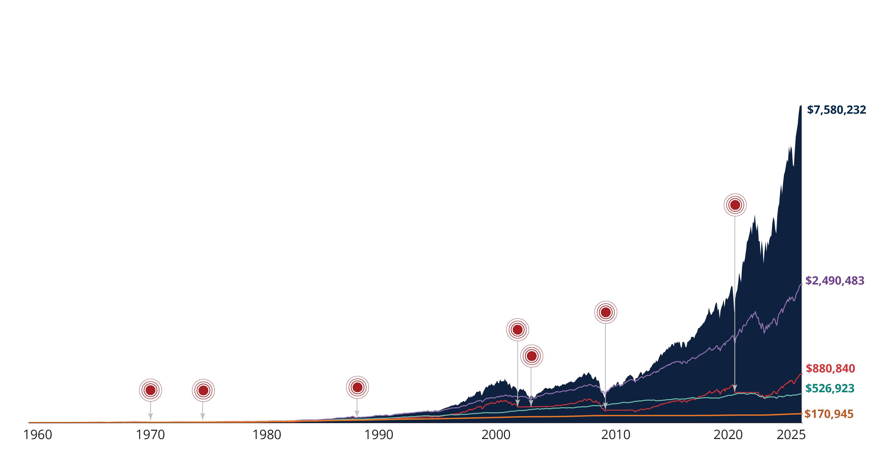
Volatility Should Be Expected: The Price of Panic
$10,000 Invested in S&P 500 Index 1960–2025
n Equity Investor: S&P 500 Index
n Balanced Investor: 50% Stocks / 50% US investment-grade bonds
n Bond Investor: US investment-grade bonds
n Reactionary Investor: Invests in the S&P 500 Index, moves 100% into cash (noted by the red circles), then moves 100% back into the S&P 500 Index two years later
n Cash Investor: Treasury Bills
Market drop of 30% or more
Initial
Investment
$10,000
PAST PERFORMANCE DOES NOT GUARANTEE FUTURE RESULTS. Indices are unmanaged and not available for direct investment. For illustrative purposes only. Unmanaged index returns do not reflect any fees, expenses, or sales charges. US Treasury securities are backed by the full faith and credit of the US Government. Equities and bonds are subject to risks and may not be in the best interest of all investors.
Indices Represented for Each Asset Class: Equity: S&P 500 Index; Bonds: IA SBBI Long Term Government Index through 12/31/75, Bloomberg US Aggregate Bond Index thereafter; Cash: IA SBBI US 30 Day T-Bill Index through 11/30/91 and the Bloomberg 1-3 Month US Treasury Bill Index thereafter. Data Source: Ned Davis Research and Morningstar, 2026
Notes:
Now let’s look at five hypothetical investors that went through these seven panic markets from 1960-2025. All seven of these investors invested $10,000 in 1960.
The first investor is the cash investor - the orange line. He buried his $10,000 in the backyard next to his shop down in his fresh water supply, right? He said, "I don't want to take any risk, and don't want to be in the markets. I just want to hide it away.“ This investor enjoyed some high interest rates that helped his cash investments. During the 1980s short-term interest rates hit 16%. People were getting some pretty good returns on cash back in the 1980s. At the end of 2025, the cash investor ended up with [read slide].
The second investor we’ll discuss is the equity investor, represented by the dark blue area. This investor invested all his money in the markets and never took it out through any of the ups and downs. He experienced wild volatility throughout this period. But he got the most money of anyone. This investor’s $10,000 grew to [read slide].
The green line represents the Bond investor who said, “I’ll only invest in fixed-income.” Until 2022, this investor enjoyed 30 previous years of falling interest rates which tend to be beneficial to bond investors. Their investment of $10,000 grew to [read slide]. This isn’t a bad return. However, as you can see, rising interest rates last year have created challenges for bond investors.
The Balanced investor represented by the purple line, followed an approach that appeared to offer a steady balance between risk and return over time. This investor said, “Invest half of my money in the stock market and half in the bond market the entire time.” This investor didn’t enjoy the highest highs or the lowest lows, but they limited some volatility and experienced a smoother ride than the equity investor. They ended up with [read slide].
Finally, let’s discuss the reactionary investor, represented by the red line. This person is otherwise known as the panic-investor. This investor said, “I’m an equity investor but every time the market goes down 30 percent, I want out—just get me out. I like the markets, but every time we're down 30 percent, I can't take it anymore. Let me hit the panic button and sit on the sidelines for two years and I’ll get back in."
There are seven panic buttons here and each time we hit one this investor moved their money to cash investments for two years. Therefore, the maximum amount of time that this investor would have been out in the markets would have been 14 years out of the 62. Look what happened to his return. This person ended up with [read slide]. Despite the fact of being invested in equities most of the time, he ended up with far less than the bond, balanced, and equity investor. The investment decisions the reactionary investor made because of fear reveals the missed opportunities that can result by getting out of the market at the wrong time.
We just looked at five different investment paths, each with its own pros and cons depending on the environment. And it raises a natural question: Wouldn’t it be nice to have someone help you choose the path that’s right for you—not too risky, not too safe, but aligned with your financial goals?
We’ll talk about that next.

Slide 23
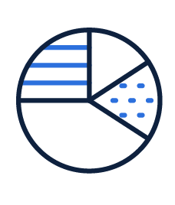
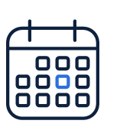

Why Working With a Financial Professional Matters
Don’t Go It Alone
Guidance to stay calm and avoid panic moves
Set Your Allocation
Mix tailored to goals and risk comfort
Make Your Money Last
Plan withdrawals and investing so savings last
Notes:
We’ve talked about how uncertainty can knock investors off course. The reality is, maintaining perspective on your own is hard—especially when markets are falling fast. That’s where a financial professional can help: expertise, outside perspective, and a steady process when emotions run high.
Three ways a pro helps you keep perspective:
Don’t Go It Alone
When the market’s plunging, sticking to a plan gets tough. A financial pro is your steady guide—someone to talk through decisions with, helping you avoid panic moves that could derail long‑term results.
Set Your Allocation
Your mix of stocks, bonds, cash, and other investments is a major driver of long‑term outcomes. It’s not one‑size‑fits‑all—it’s built around your goals, time horizon, and comfort with market drops. A financial pro can design (and adjust) an allocation that aligns to your situation and stays aligned as life changes.
Disclosure: Diversification/asset allocation does not ensure a profit or protect against a loss.
Make Your Money Last
As you get closer to retirement—or if you’re already in retirement—the challenge shifts. You’re no longer adding to your investments; you’re relying on them to fund your life. A pro can help you figure out how much you can withdraw, how to pace your spending, and how to invest so your money has the best chance of lasting as long as you need it.
Next, let’s summarize what we covered today.

Slide 24

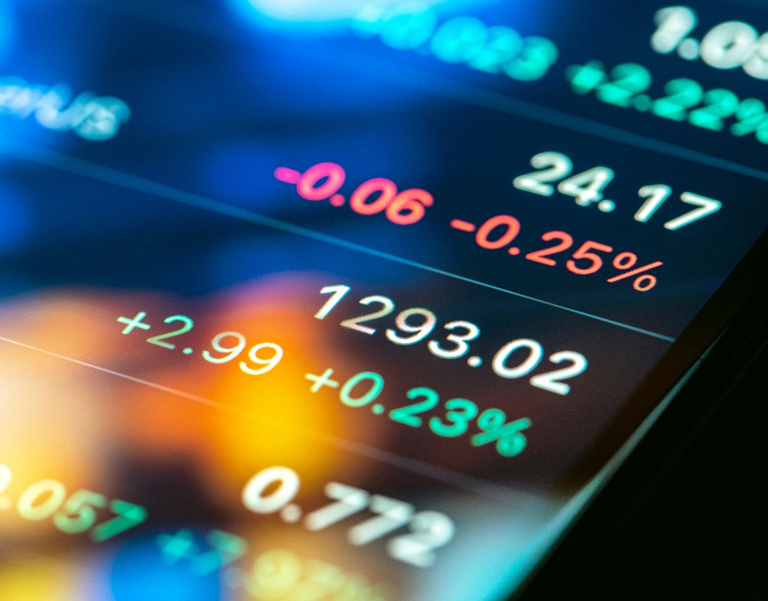
Summary
Stress, Anxiety, and Crises
Instinctual Behavior
Maintaining Perspective
Notes:
To summarize, today we discussed [read slide]
24

Slide 25

The Bottom Line
How many times does the end of the world as we know it need to arrive before we realize that it’s not the end of the world as we know it?
Michael Lewis
Author of “The Big Short”
Copyright © 2024 by Hartford Funds.
Notes:
Here’s the bottom line. (read slide)

Slide 26
Next steps
Remember America’s recovery record
If you’re feeling uneasy about the markets, call your financial professional
Get a copy of our Maintaining Perspective in Uncertain Times brochure
MAI474
Notes:
Here are a few simple next steps that can help you maintain perspective long after today’s discussion:
First: Remember America’s recovery record.
We’ve had 27 bear markets—and 27 recoveries.
Every single one. That history doesn’t make downturns feel good, but it does remind us that they’ve always been temporary.
Second: If you feel uneasy—when the market drops suddenly or headlines escalate—call your financial professional before making a move.
Just talking it through with someone who sees the bigger picture can help you avoid a decision that might hurt long‑term results.
Third: Grab a copy of our Maintaining Perspective in Uncertain Times brochure.
It reinforces the key ideas from today and gives you something to revisit anytime the market feels shaky.
26

Slide 27
Index Definitions
Dow Jones Industrial Average is a price-weighted average of 30 significant stocks traded on the New York Stock Exchange and the Nasdaq.
S&P 500 Index is a market capitalization-weighted price index composed of 500 widely held common stocks.
Bloomberg US Aggregate Bond Index is composed of securities that cover the US investment-grade fixed-rate bond market, with index components for government and corporate securities, mortgage pass-through securities, and asset-backed securities.
Bloomberg 1-3 Month US Treasury Bill Index is designed to measure the performance of public obligations of the US Treasury that have a remaining maturity of greater than or equal to 1 month and less than 3 months.
IA SBBI US 30 Day T-Bill Index measures the performance of a single issue of outstanding Treasury bill which matures closest to, but not beyond, one month from the rebalancing date. The issue is purchased at the beginning of the month and held for a full month; at the end of the month that issue is sold and rolled into a newly selected issue.
IA SBBI LT Government Index measures the performance of a single issue of outstanding US Treasury note with a maturity term of around 5.5 years.
Indices on Slide 20:
Large-Cap Growth Stocks are represented by the Russell 1000 Growth Index, which measures the performance of those Russell 1000 Index companies with higher price-to-book ratios and higher forecasted growth values. Large-Cap Value Stocks are represented by Russell 1000 Value Index, which measures the performance of Russell 1000 Index companies with lower price-to-book ratios (the ratio of a stock’s price to its book value per share) and lower forecasted growth values. Mid-Cap Stocks are represented by the Russell Midcap Index, which measures the performance of the mid-cap segment of the US equity universe. Small-Cap Stocks are represented by the Russell 2000 Index, which measures the performance of the small-cap segment of the US equity universe. International Stocks are represented by the MSCI EAFE Index, which measures developed market equity performance, excluding the US and Canada. Emerging Markets Stocks are represented by the MSCI Emerging Markets Index, which measures equity market performance in the global emerging markets. Core Bonds are represented by the Bloomberg US Aggregate Bond Index. Short Duration Bonds are represented by the Bloomberg 1-3 Year Gov’t/Credit Index, which is comprised of the US Gov’t/Credit component of the Bloomberg US Aggregate Bond Index. Cash Investments are represented by the Bloomberg 1-3 Month US Treasury Bill Index. Diversified Portfolio is represented by an equal portion of each asset class, excluding cash.
Important Risks: Investing involves risk, including the possible loss of principal. • Fixed-income security risks include credit, liquidity, call, duration, and interest-rate risk. As interest rates rise, bond prices generally fall. • US Treasury securities are backed by the full faith and credit of the US government as to the timely payment of principal and interest • The securities of large market capitalization companies may underperform other segments of the market. • Small- and mid-cap securities can have greater risks, including liquidity risk, and volatility than large-cap securities. • Foreign investments may be more volatile and less liquid than US investments and are subject to the risk of currency fluctuations and adverse political, economic and regulatory developments. These risks may be greater, and include additional risks, for investments in emerging markets. • Different investment styles may go in and out of favor, which may cause underperformance relative to the broader stock market.
Index Provider Notices may be found at hartfordfunds.com/index-notices.
Hartford Mutual Funds may or may not be invested in the companies referenced herein; however, no particular endorsement of any product or service is being made.
The MIT AgeLab is not an affiliate or subsidiary of Hartford Funds.
Hartford Funds Distributors, LLC, Member FINRA.
SEM_Uncertain 0426 5363126

