Slide 1


Mastering
Facebook
Acquire clients using the world’s most powerful social media tool
Developed in collaboration with Oechsli
© 2023 by Hartford Funds. FOR FINANCIAL PROFESSIONAL/INSTITUTIONAL INVESTOR USE ONLY. NOT FOR USE WITH THE PUBLIC.
Notes:
Facebook has been around since 2004. But it’s usage by financial professionals is still building momentum.
There are so many features to tap into, so many terms to learn. It’s why many business users never go beyond very basic usage (setting up a business page and posting occasionally).
In today’s session, our goal is to help you take your Facebook usage to the next level.
This presentation was built in partnership with Oechsli, a leading marketing firm for financial professionals. They’ve worked with thousands of financial professionals to help improve their social media usage and I think you’ll find their insights very relevant.

Slide 2

Conducts semi-annual research on two critical groups: elite financial professionals and affluent investors
Findings are used to help financial professionals attract, serve, and develop loyal affluent clients
When implementing any of the strategies referenced in this presentation, please follow Edward Jones legal and compliance policies regarding social media.
Notes:
Read slide

Slide 3
Agenda
Social Media Preferences of Affluent Investors
Personal Profile vs. Business Page
Three Facebook Strategies
Notes:
Here are three areas we’ll consider [read slide]
3

Slide 4


Social Media Preferences
of the Affluent
© 2023 by Hartford Funds. FOR FINANCIAL PROFESSIONAL/INSTITUTIONAL INVESTOR USE ONLY. NOT FOR USE WITH THE PUBLIC.
Notes:
First, let’s talk about…

Slide 5
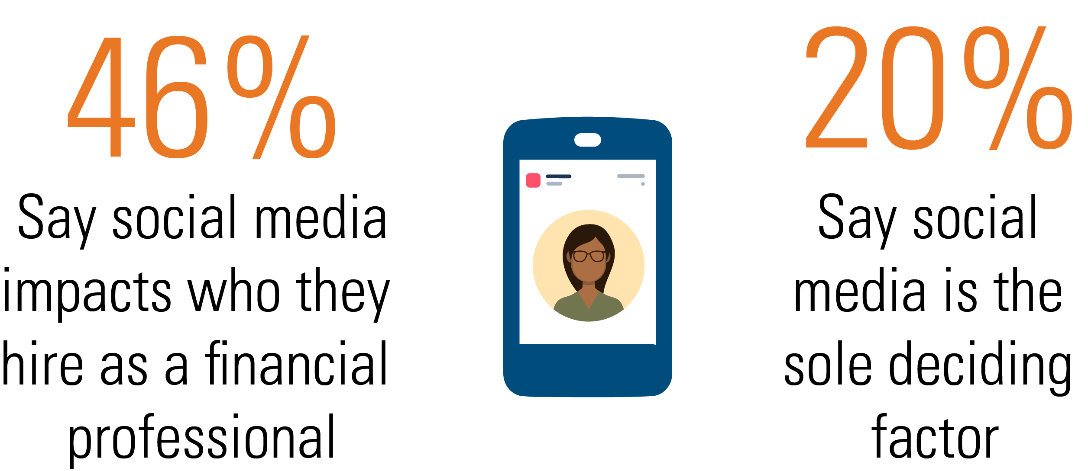
Social Media Affects Choices
Source: Hartford Funds Survey, 2021
Notes:
In a 2021 Hartford Funds survey, 46% of consumer respondents said social media impacts who they hire as a financial professional, and 20% cited social media as the sole deciding factor in their decision making.

Slide 6
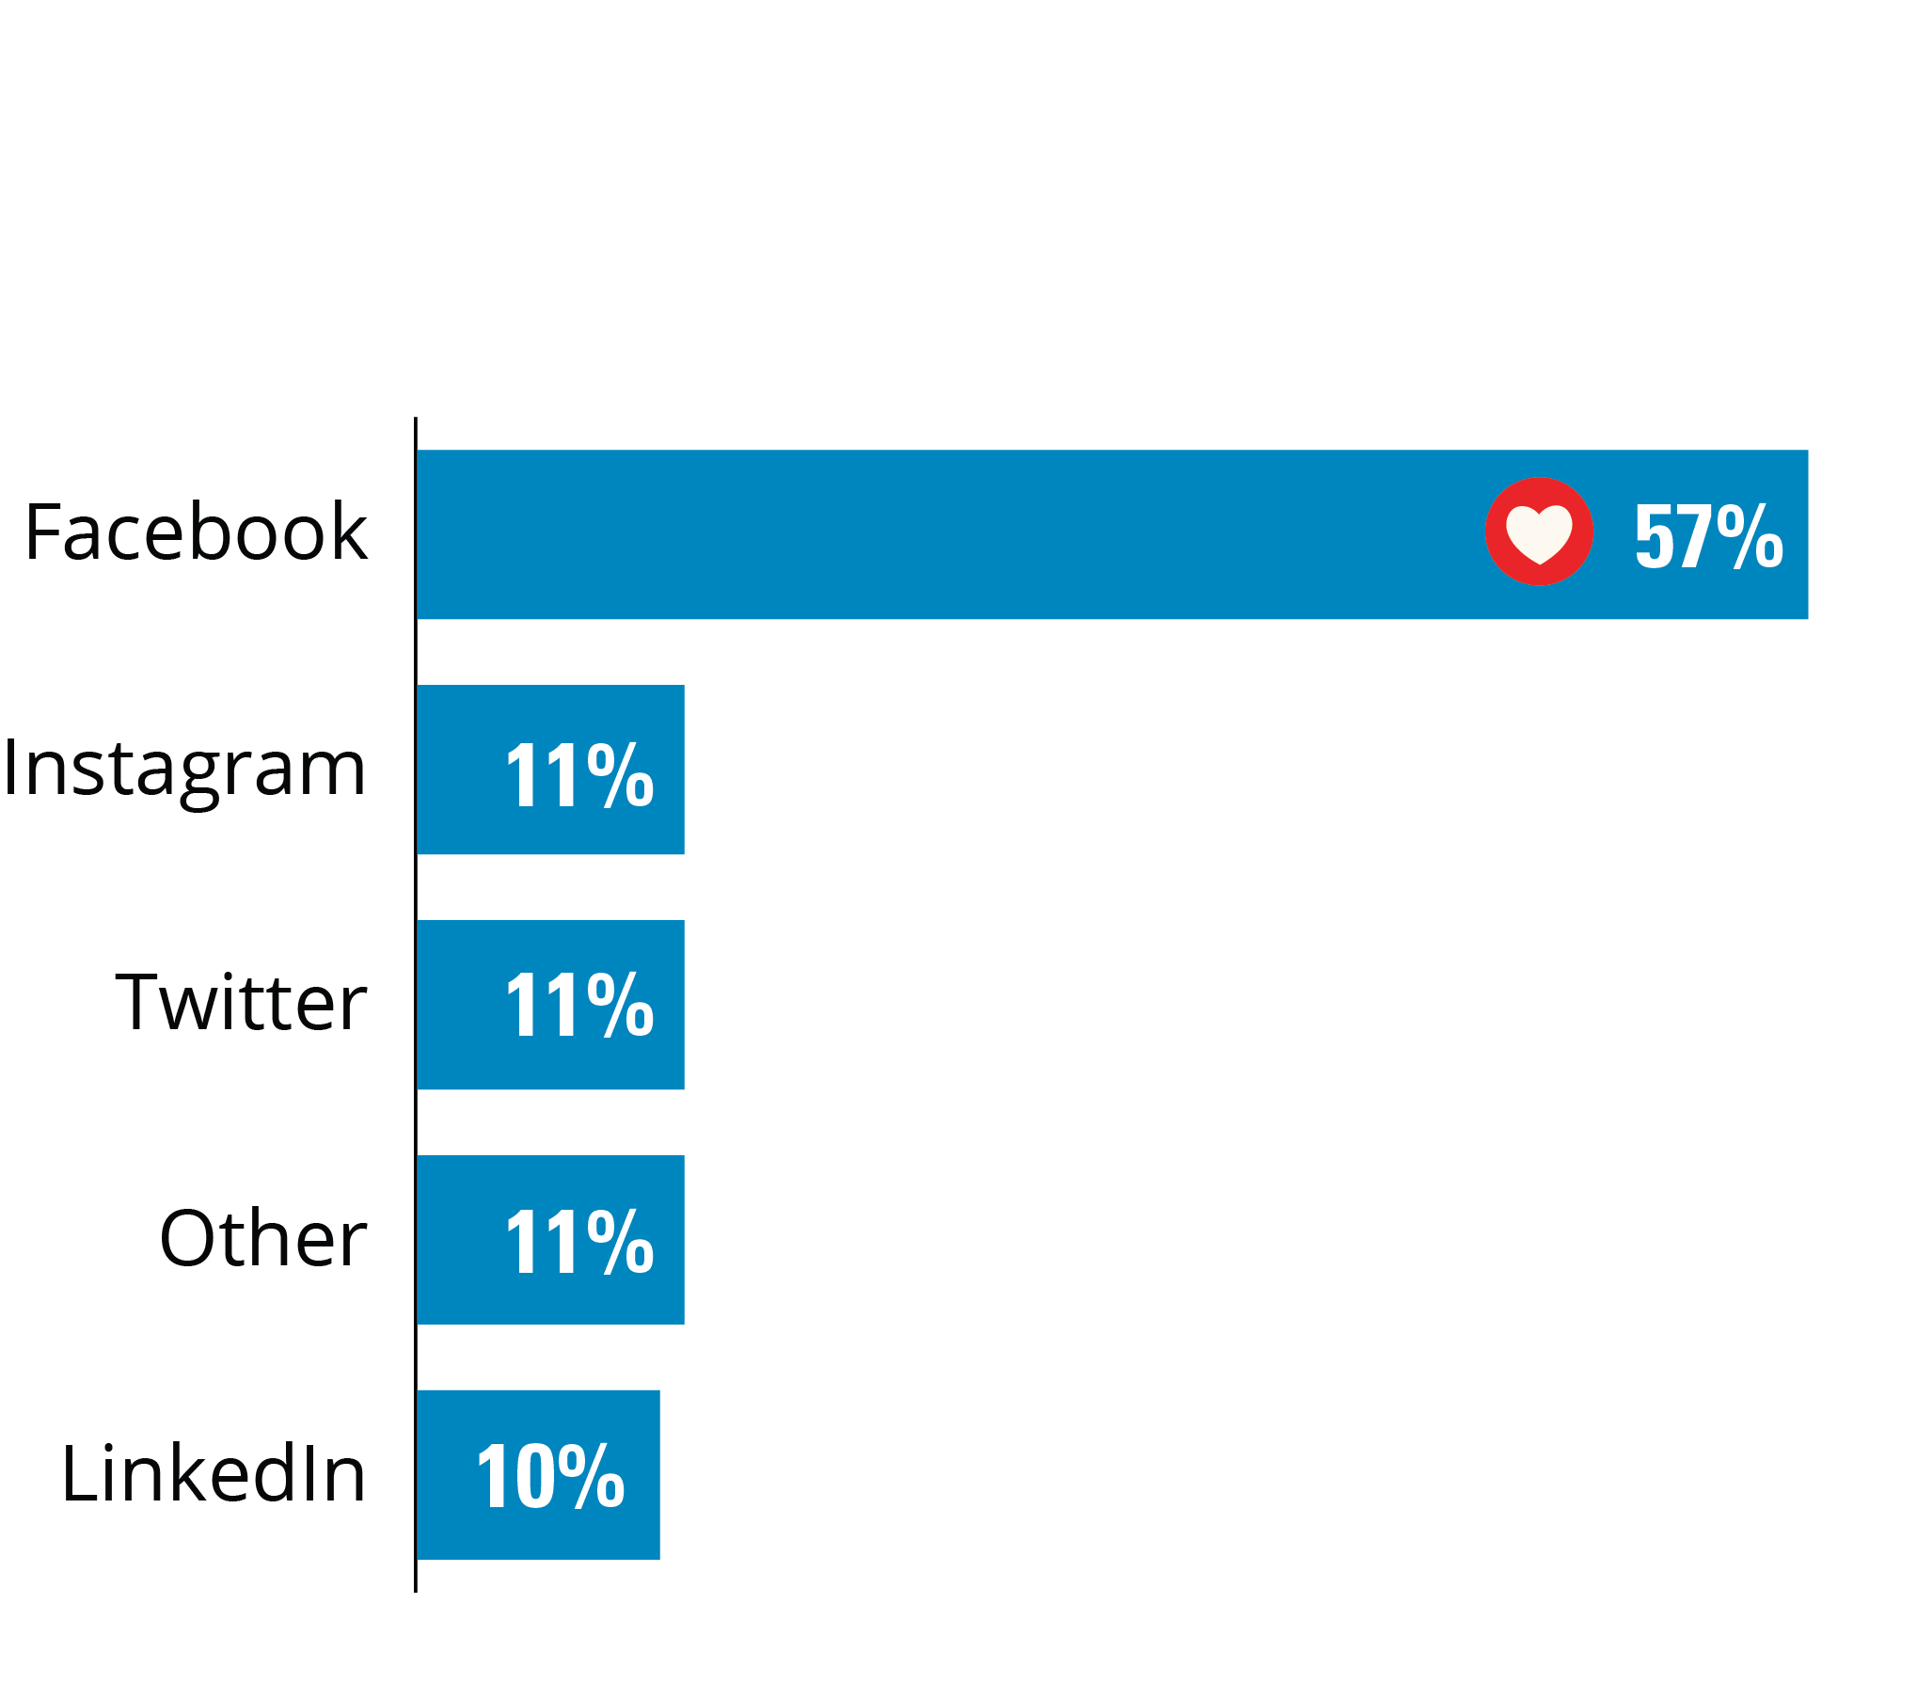
Affluent Investors’ Favorite
Source: Oechsli, 2021
Notes:
When it comes to using social media, LinkedIn is often seen as a natural starting point for financial professionals. But the affluent use Facebook more frequently and fill it with much more personal information.
In a 2021 Oechsli survey, affluent investors were asked for their favorite social network. As you can see, Facebook was the clear winner.

Slide 7
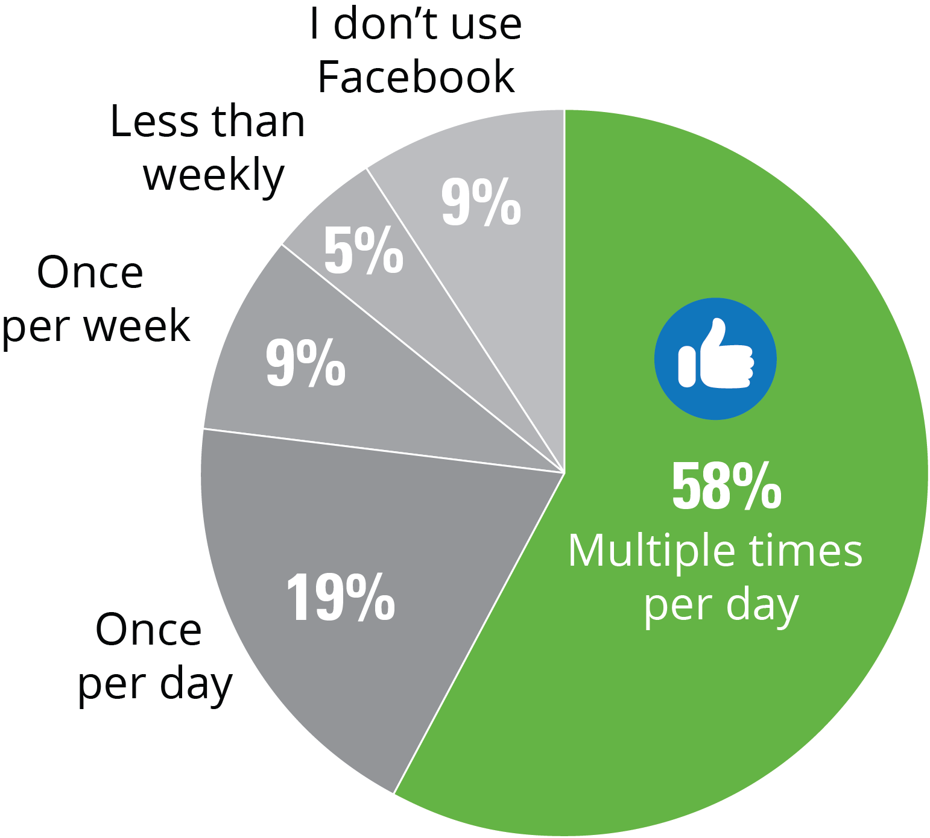
Used Multiple Times Per Day
Source: Oechsli, 2021
Notes:
You’ll also notice how often they use Facebook; 58% say they use it multiple times per day.

Slide 8
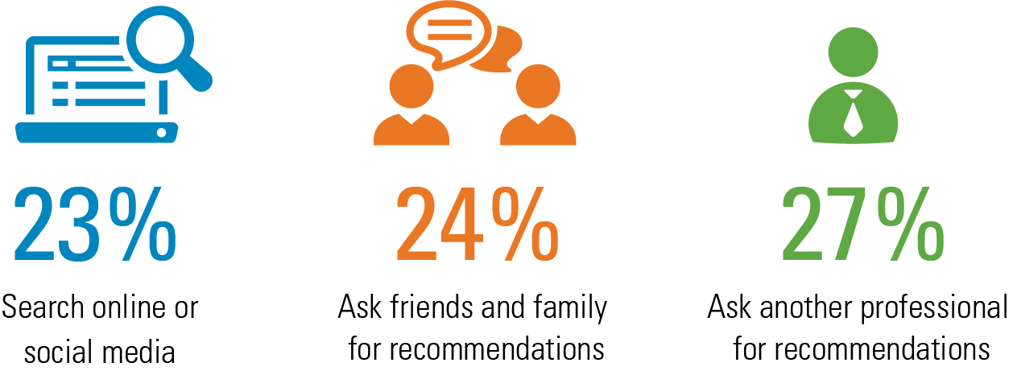
Searches for You May Start Online
How affluent investors search for a financial professional
Source: Oechsli, 2023
Notes:
One of the biggest, long-term advantages of Facebook marketing is having an online presence to help you thrive in a digital world.
When looking for a financial professional, affluent investors tend to rely on friends, family, and professional recommendations. However, there’s a trend toward using online searches and social networks. Last year 13% began their search online; this year it’s 23%.
Source: Oechsli, 2023

Slide 9

Success Story
Building Client Relationships
A Philadelphia-based financial professional has used Facebook to deepen his client connections, and says referral business is at an all-time high. He engages with their non-financial posts, and references their posts in conversation.
Source: Oechsli, 2021
Notes:
Read slide

Slide 10


Personal Profile vs.
Business Page
© 2023 by Hartford Funds. FOR FINANCIAL PROFESSIONAL/INSTITUTIONAL INVESTOR USE ONLY. NOT FOR USE WITH THE PUBLIC.
Notes:
Our second section is…

Slide 11
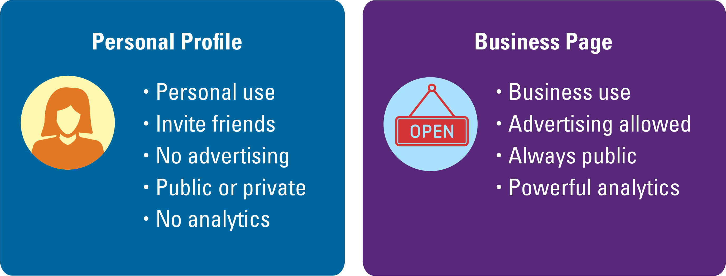
Each Has a Purpose (You Need Both)
Notes:
We’re often asked about the difference between using Facebook personally vs. for a business.
Everyone should start by creating a personal profile. It enables you to connect personally with your friends, clients, and centers-of-influence (COIs). Most of you probably have this already. The idea is to share photos, videos, and messages with your friends.
You’re going to need to have a personal profile to create a business page. This enables you to share business-related content, build a following, and advertise to potential clients.

Slide 12

Success Story
New Business From Boosted Posts
A Charlotte-based financial professional boosted a post using “We focus on helping business owners with their investments” as the main message. A business owner who was new to the area saw the post, noticed some mutual friends, and decided to reach out. Three meetings later he was a new $1.8 million client.
Source: Oechsli, 2021
Notes:
Read slide

Slide 13


3 Facebook Strategies
© 2023 by Hartford Funds. FOR FINANCIAL PROFESSIONAL/INSTITUTIONAL INVESTOR USE ONLY. NOT FOR USE WITH THE PUBLIC.
Notes:
Finally, let’s discuss our last section.
We’ll cover three strategies that can help deepen your connections with existing clients and help you find new clients as well.

Slide 14
Effective Actions by Network
 | Facebook | LinkedIn
Post personal updates | Always | Sometimes
Post professional updates | Sometimes | Always
Send connection requests to... | People you know | Anyone
Send direct messages to... | No one | Prospective clients identified as “ideal clients”
Ask clients about their connections | Never | Selectively
Source: Oechsli, 2021
Notes:
Before we cover the four strategies, let’s discuss Oechsli’s recommendations for what to do on Facebook vs. LinkedIn.
So, why Facebook instead of LinkedIn? Both platforms have tons of value, but the use case for Facebook is a little different.
Its biggest selling point is that it helps you stay in tune with what’s happening in your clients’ lives.
The secondary benefit, from an advertising perspective, is that Facebook is the larger and more targetable of the two, boasting 3 billion users (Source: Number of monthly active Facebook users worldwide as of 2nd quarter 2023, Statista, 8/22/23), compared to LinkedIn’s 900 million (source: LinkedIn, 2023).
LinkedIn is great for making connections, finding introduction opportunities, and sharing business-related content. It’s also great for focusing on a certain company or occupation.
In practicality, here’s how you’d use them differently. (Discuss table)

Slide 15

1. Personal Connections
Facebook gives you the opportunity to engage with clients in between appointments
Like, comment, share, etc. on client and prospective client non-financial posts
Notes:
Strategy number one is using Facebook for what it was originally built to provide—personal connections
There are only so many times per year you can meet with a client. In between those meetings or social outings, Facebook gives you the chance to continue engaging and learning about them
You’re seeing their new grandchild, new job, new baby, new house, the trip they took to France, or the friends they play tennis with… It all helps
Edward Jones now allows financial professionals to like, love, comment, share, etc. on client and prospective client non-financial posts

Slide 16
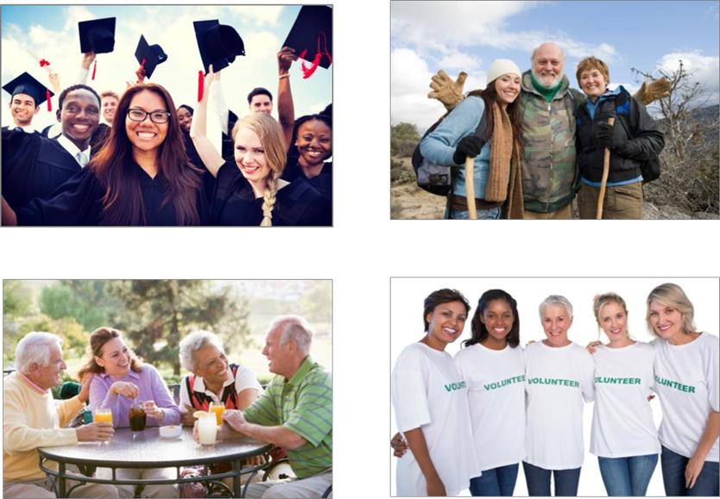

Deepen Personal Connections
Check clients’ Facebook feeds prior to review meetings or touch-base calls
In your meetings, reference posts from the past week
On your profile, post about your personal life
Your Priorities
Educate
Recreate
Congregate
Donate
Notes:
You’re all in a different place with Facebook usage right now, but here’s a quick game plan for using it to deepen client connections.
Check your clients’ Facebook feeds prior to review meetings or touch-base calls. In your meetings, reference posts from the past week. This is perfectly acceptable, but not if you’re referencing something that happened last year.
On your business page, occasionally post about your personal life. Relationship building is a two-way street. Clients will deepen their connection with you as they learn about your family, hobbies, and interests.

Slide 17
2. Top-of-Mind Awareness
When someone in your area thinks “financial professional,” who comes to mind?
Notes:
Now let’s shift gears and talk about what’s possible with a business page.
When you post regularly, people in the community get to know you and your ideas
In the old world, awareness-building took place in newspaper ads or TV commercials. Now it happens much more cost effectively through social media.
When someone decides to retire, inherits some money, or sells a business, who do they think of for financial guidance?
If it’s not you, it’s fixable, but you have to understand how the Facebook algorithm works
When you post something to your business page, let’s say an article on Social Security, you might think that all your followers (those who’ve “liked” your page) would see it.

Slide 18

Boosting Posts
The average organic reach of a normal post is between a range of 1.52%–2.58%*
A “boosted” post is a regular Facebook post that you pay to reach a wider audience
Boosting helps extend your reach
*Source: Here’s What You Can Do About Organic Reach Decline in 2023, Hootsuite, 8/1/23
Notes:
On average, only 1-3% of your Facebook followers see your unadvertised posts. That statistic is called your “organic reach” and it’s quite low on Facebook. Organic Reach Rate (ORR) is the percentage of your followers (page likes) who see your posts WITHOUT spending money on ads.
Boosting Posts is an easy way to extend your reach. Boosting is basically advertising on a post-by-post basis. So, say you want a specific post to get more views—you might consider spending $25 to boost it.
Choose posts to boost. Edward Jones has identified posts that are optimal for boosting. Search their Hearsay library for the “boostable” tag.

Slide 19
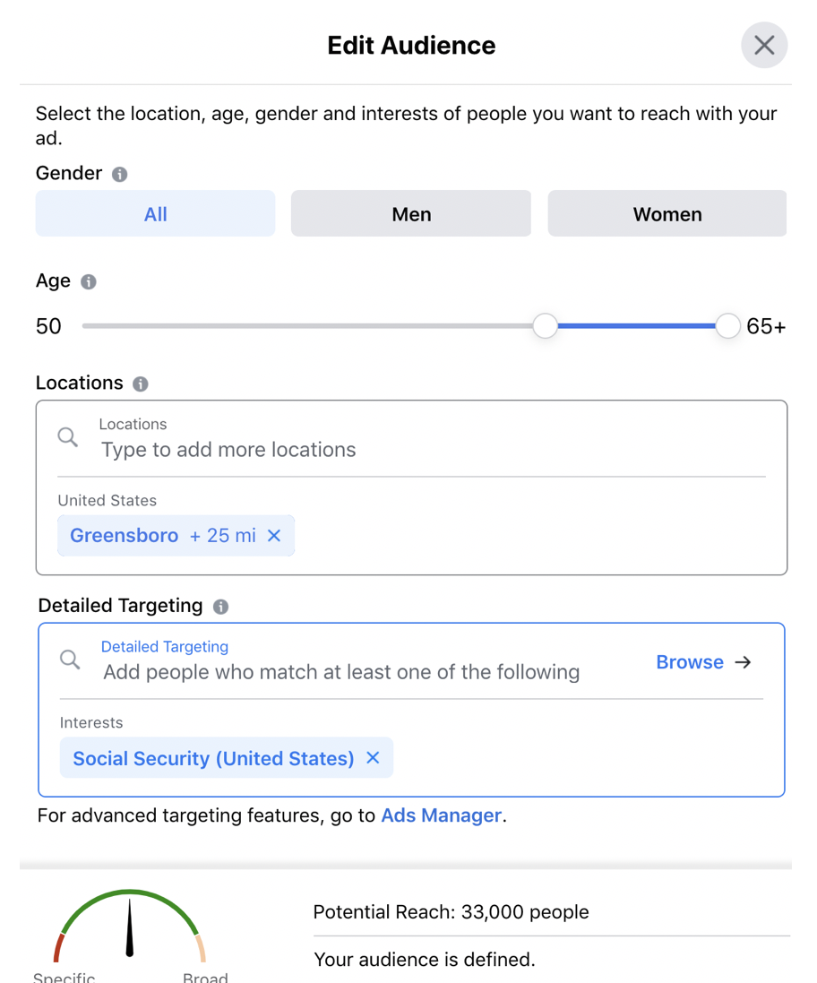
Choose Specific Audiences Such As:
Users who are age 55-65
Live within 25 miles of your office
Have shown interest in Social Security
Notes:
It’s important to note, you’re not telling Facebook to simply show your post to more people—you’re specifying the audience.
Going back to our previous example of the Social Security article, you could boost that post to those who:
Are of a certain age
Live in the within 25 miles of your office
Have shown interest in Social Security topics before
You wouldn’t boost every post, but it’s a great strategy for 3-4 of your best posts every month.

Slide 20
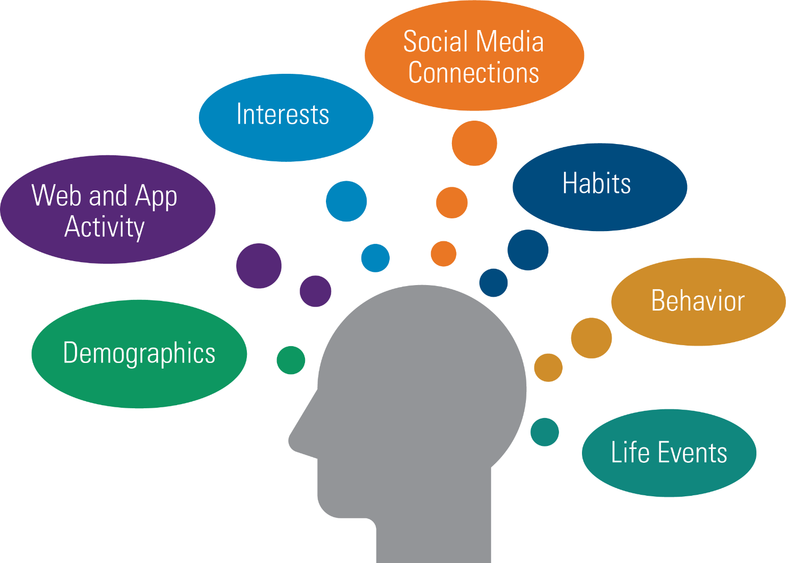
Powerful Targeting Tools
Notes:
Facebook advertising is based on finding the audiences that are most likely to become your fan or your customer. These targeting options focus directly on users and profiling potential customers to get clicks and grow your business.
Facebook can automatically show your ads to people who are most likely to find your ads relevant. And you can further target your ads using criteria such as demographics, interests, behaviors, social media connections, and more.

Slide 21
Become Top-of-Mind
Only boost pre-approved content
Search for “boostable” tag
Boosting is an approved business-related expense
Think about your ideal client in Facebook terms
Boost your first post and monitor the results
Notes:
Review bulleted list
Edward Jones has identified posts that are optimal for boosting. Search their Hearsay library for the “boostable” tag.
Determine your monthly budget. $100 is a good place to start, but if you want bigger results, you’ll want to increase your budget.
Think about your ideal client in Facebook audience terms. Facebook doesn’t have a way to select “those who need a new financial professional.” You will need to think about your ideal client’s age, location, occupation, and other criteria that are identifiable on Facebook.
Finally, boost your first post. Although you’re somewhat ensuring that more people will see it, you still have to monitor your statistics. Keep an eye on Engagements and Link Clicks in particular as you want those metrics going up consistently.

Slide 22
3. Provide Social Proof
“We view a behavior as more correct in a given situation to the degree that we see others performing it.”
—Robert Cialdini, PhD
Notes:
Let’s dive into the final section here. Social proof may be a new term for some of you, but everyone here has experienced its impact.
In the book, Influence: The Power of Persuasion, Robert Cialdini wrote about the concept of “social proof.” He made the point that “we view a behavior as more correct in a given situation to the degree that we see others performing it.” In other words, we inherently trust the decisions that many other seemingly-normal people have made.
You can play into this on your Facebook Business Page. If someone lands on your page and sees a great number of followers, many of whom they know, and they see that your posts garner high levels of engagement, it gives you instant credibility.

Slide 23
Gather more followers so you can advertise to them and their friends
Notes:
If you think about it, many of your new clients over the next five years, will likely come one degree removed from an existing client. Why not get in front of them right away with Facebook’s help?
Gathering more followers over time isn’t all about social proof, it also gives you the ability to advertise to those followers and their friends.
I’m not going to get into how specifically how to run these type of ads today. My point is to raise awareness that this type of targeting exists.

Slide 24
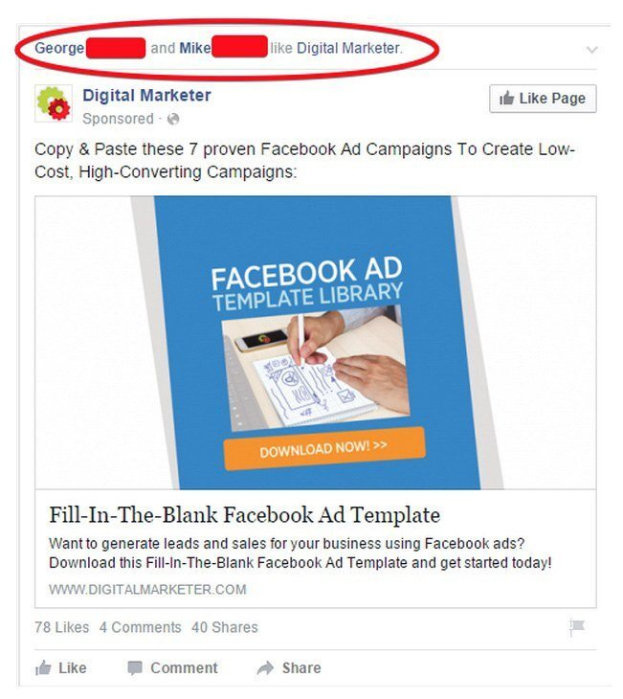
Advertise to Your Followers’ Friends
Notes:
You’ve likely all seen this type of ad in your Facebook feed before. It says one of your friends likes a certain brand. They didn’t just go in and follow (or like) that brand.
Because they liked them in the past, that brand now can reference them in advertising
For any of this to work, you need followers. Encourage your clients to follow your page. Encourage your friends and COIs too. You can even run ads soliciting new followers to your page. Over time, you’ll have a nice audience to advertise through.

Slide 25
Summary
Social Media Preferences of Affluent Investors
The most popular social media app
Personal Profile vs. Business Page
Promotion and intel
Three Facebook Strategies
The more you use them, the better your skills become
Notes:
To summarize, today we discussed [read slide]
25

Slide 26

The Bottom Line:
“Facebook can help you reach prospective clients you wouldn’t reach using traditional prospecting methods.”
Stephen Boswell, President and CEO, Oechsli
© 2023 by Hartford Funds. FOR FINANCIAL PROFESSIONAL/INSTITUTIONAL INVESTOR USE ONLY. NOT FOR USE WITH THE PUBLIC.
Notes:
Here’s the bottom line. [Read slide]

Slide 27
Next Steps
Create your Facebook business page
Begin engaging with clients’ posts by commenting or using reaction emojis
Select some “boostable” content to boost and monitor results
Financial professional workbook MAI330EJ
Oechsli is not an affiliate or subsidiary of Hartford Funds
Hartford Funds Distributors, LLC, Member FINRA. REP_FacebookEJ 0923 3092127
Notes:
Read slide
27

